Slide 1

VTPBIS Expanding and Enhancing Targeted
Interventions Training for Social and Academic Success
Kristin M. Beswick
Cassandra Townshend
All materials can be found here:
bit.ly/VTBEST2021

Slide 2
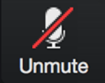
Zoom 101
Post your questions in the chat and keep an eye out for posted links or files.
Open the Participants panel to see who’s here and update your name:
* Hover over your name in the list and click “More”
* Then click “rename” to change your display name
Turn your microphone and webcam on and off
(Please stay muted when presenter is speaking)
Use the “Reactions” to raise your hand, give a thumbs up, and other interactive reactions.
You can raise your hand if you have a questions or post your question in the chat.
Notes:
Please change your name so it indicates which school you are in.

Slide 3
Day 1 Coming Together
Please share in the chatbox . . .
Something you are grateful for today.

Slide 4
Learning Objective
Together, you will have:
Expanded current thinking about student needs and how to meet them equitably;
Strengthened and enhanced your school's inventory of targeted interventions to ensure equitable access;
Identified and used data to monitor progress and make decisions about duration, modification, and fading;
Heard examples from colleagues; and
Planned a process for supporting staff to implement targeted interventions with fidelity
Notes:
Introduce “To Do” Checklist

Slide 5
Day 1 Agenda
Consider your school’s existing systems that support student behavior
Explore ways to strengthen Universal supports
with the following in mind:
Post-pandemic recovery year
Additional initiatives
Equity for all students
Ensure your school’s Universal and Targeted teams are functioning efficiently and effectively
Begin to explore Targeted practices that support student behavior
Access
Representation
Meaningful Participation
High Outcomes

Slide 6
Why are we here: Common School Scenarios
Targeted supports were implemented but student success varied
Targeted supports were implemented but were not able to maintain due to staffing, buy-in, teaming challenges or lack of fidelity
Targeted supports were implemented but Universal supports were not sustained leading to increased numbers of requests for assistance
Targeted supports were implemented with fidelity and the team is looking to add on additional supports
Notes:
Why was the Enhancing your Targeted Interventions added?

Slide 7
Activity 1
In your breakout group discuss:
what scenario you most closely relate to?
what you hope to accomplish over the next four days.
Come back ready to share one goal for this week!
Notes:
modify this

Slide 8
Supporting
Staff Behavior
OUTCOMES
Supporting
Decision Making
Systems
Data
Practices
Supporting Student Behavior
Notes:
3
SYSTEMS – we may need to shift our systems a bit to accommodate the needs of families and students post-pandemic. How can we beef up our universal supports or rethink the implementation of targeted supports for all students? We have to use our DATA (or anticipated data) to proactively keep many students who may be behind from exhausting our available supports or overwhelming referrals for special education.

Slide 9

Our Current Context:
Recovery Year – Post Pandemic
Educational gaps
Increased inequities
Decreased focus
Lack of consistency
Decreased sustainability
Fatigue
Lack of confidence
AOE Recovery Framework and Overview
Chat Box
Notes:
As we enter the Recovery year, it will be even more important for school teams to consider the strengths and weaknesses of their current universal supports and those practices that can assist students socially, emotionally, academically and behaviorally.
Cassandra: This could be an opportunity to share things to considr as we enter the Recovery Year, then ask other things that may be on their minds not discussed?

Slide 10

All within the MTSS Framework: SEL, Trauma-Informed & Restorative Practices
Same end goals in mind
To build a safe, respectful, and productive
learning environment
To establish a positive school climate where students and adults have strong, positive relationships and students understand what is expected of them as learners at school
Whole-school
Positive, strengths-based
Proactive/prevention-focused
Contribute to and depend on an equitable learning environment

Slide 11
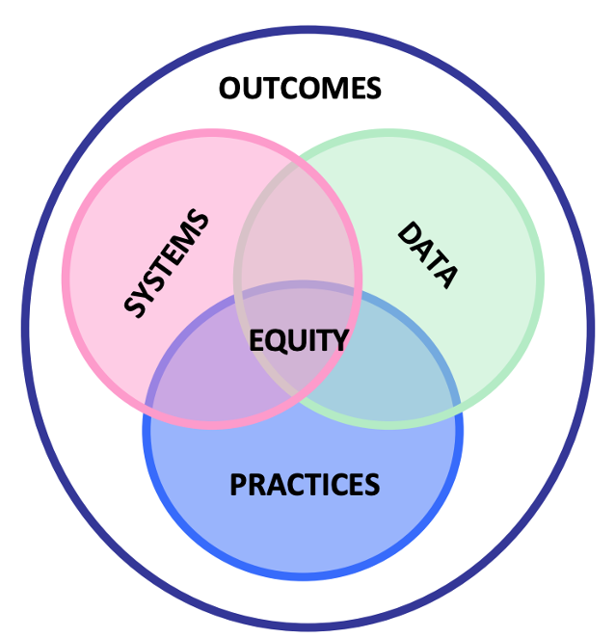
What do you notice?
“The fundamental purpose of PBIS is to make schools more effective and equitable learning environments.”
Rob Horner, OSEP Technical Assistance Center for PBIS
Access
Representation
Meaningful Participation
High Outcomes
OUTCOMES
Systems
Data
Practices
Notes:
Effective - in that the systems and practices in place are effecting LONG-term positive outcomes
Equitable - all students have the opportunity to access the learning and the opportunities to learn regardless of their abilities, gender, culture or other.
What conversations could your Universal PBIS teams be having to ensure that your systems, data and practices are not only in place, but that marginalized students are being considered, particularly those who may have suffered additional barriers during the pandemic.
How do we shift and move our systems so that student needs are being met in the classroom setting?

Slide 12
Systems that Support Staff Behavior
Supporting
Staff Behavior
OUTCOMES
Systems
Data
Practices
Notes:
Effective - in that the systems and practices in place are effecting LONG-term positive outcomes
Equitable - all students have the opportunity to access the learning and the opportunities to learn regardless of their abilities, gender, culture or other.
What conversations could your Universal PBIS teams be having to ensure that your systems, data and practices are not only in place, but that marginalized students are being considered, particularly those who may have suffered additional barriers during the pandemic.
How do we shift and move our systems so that student needs are being met in the classroom setting?

Slide 13
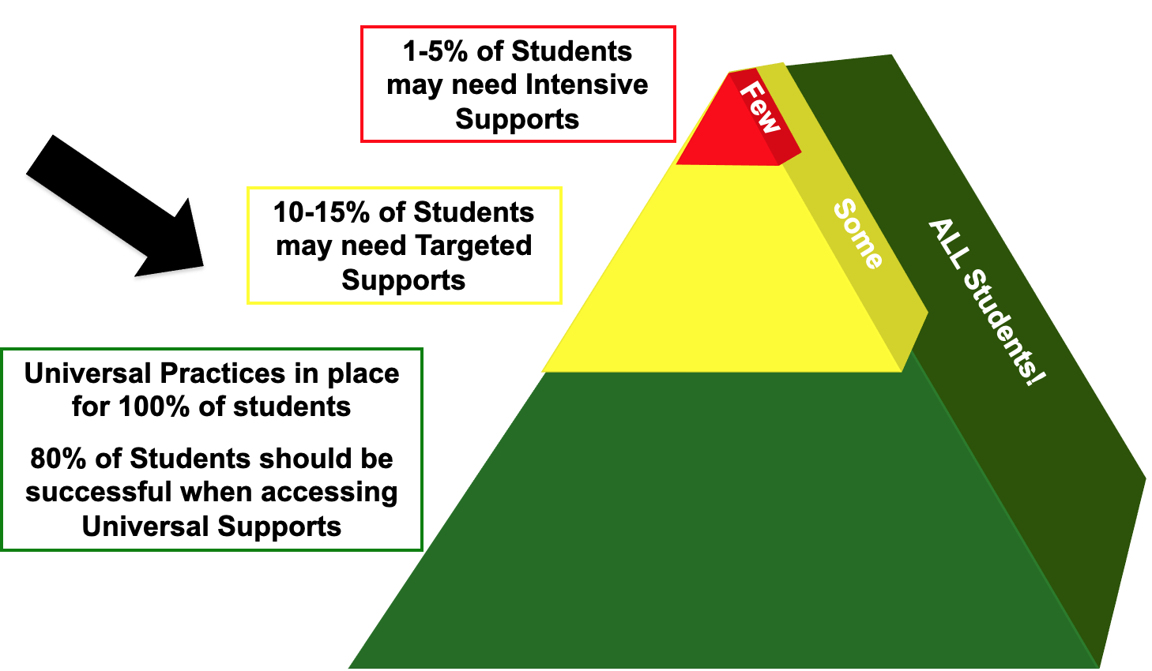
Who Benefits from MTSS that support Social and Behavioral Learning? Everyone!
Notes:
Although we are going to be focusing on Targeted Level supports, we have to stress that if a system’s universal supports are not in place with fidelity, it will be difficult to implement and sustain practices that are equitable and sustainable.
Like building a house on a crumbling foundation:

Slide 14
Foundational Elements of Equity in PBIS
Collect, use, and report disaggregated discipline data
Implement a behavior framework that is preventive, multi-tiered, and culturally responsive
Use engaging instruction to reduce the opportunity (achievement) gap
Develop policies with accountability for disciplinary equity
Teach strategies for neutralizing implicit bias in discipline decisions

Slide 15
Equity is a Tier 1/Universal Issue!
Providing Tier 2 and 3 supports to students from groups who receive disproportionate rates of referrals and suspensions does not address inequitable student outcomes.

Slide 16
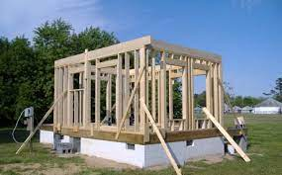
The Power of Universal Supports
Consistent
Positive
Relationships
Genuine
Engaging
Equitable
Notes:
Provide students with a sense of safety, they know what to expect from the environment.
As we head into the Recovery year, it will be even more important to consider how schools and staff can positively impact families and student:
Alleviate worry
Ensure safety
Incorporate and discuss various practices used in homes to support students
Build (in some cases re-build) academic confidence and momentum

Slide 17

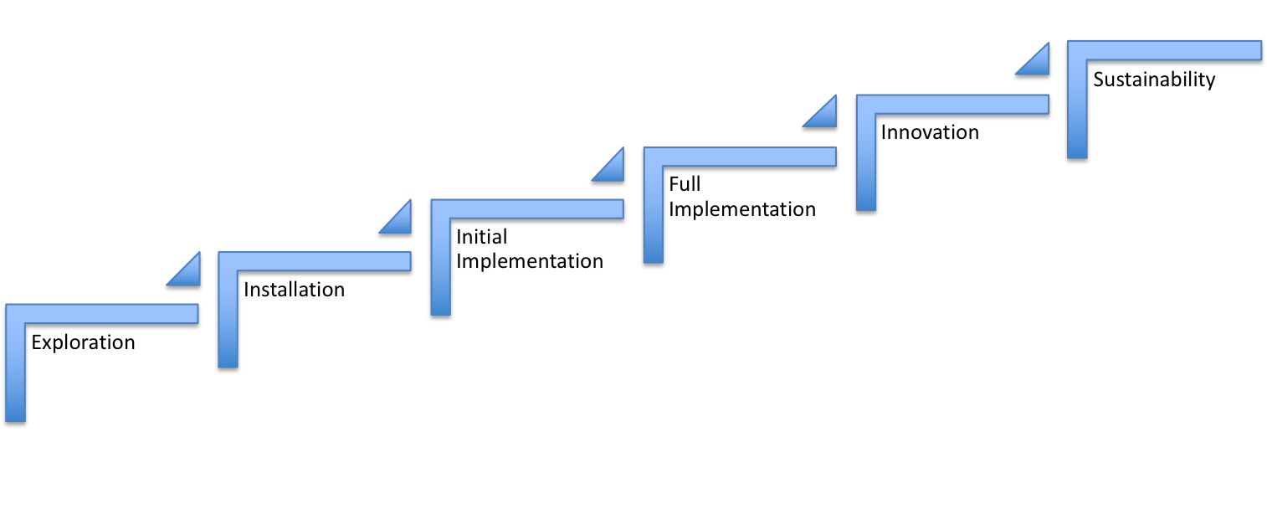
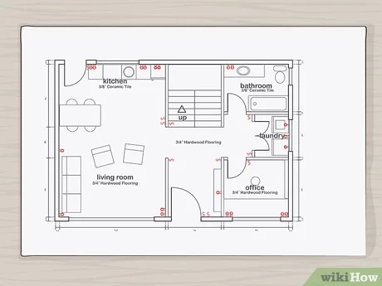
Implementation Science
2-4 years

Slide 18
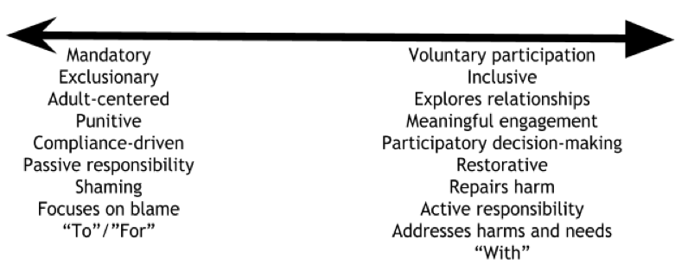
Continuum: Mindset Shift
Notes:
Offering supports when the need arises, not having students have to wait or fail to receive support, takes a shift in mindset. Implementing and sustaining MTSS efforts has caught many schools in a place of considering where they fall on this continuum.
Moving towards less exclusionary practices, making decisions with students and families, helping students to build the skills they need to be more successful – Our schools and individual staff members are at various places on this continuum. It is important to continue the efforts and move the conversations so that students can get their needs met.

Slide 19
Readiness for Targeted PBIS
Implementation at the Targeted Level
is more likely to be effective and efficient
if Universal Systems are implemented with high fidelity
(at least 70% on Tier I of the TFI).
www.pbis.org
Access
Representation
Meaningful Participation
High Outcomes
Making Assumptions…
Notes:
We bring this up to highlight the fact that not only should your universal supports be in place with fidelity, but your Targeted interventions must also be implemented with fidelity. If something is not working well, we have to not throw out the baby with the bathwater. We have to use our teams to analyze the areas that need to be strengthened. This can lead to difficult conversations, but the goal is to be responsive to student needs.

Slide 20
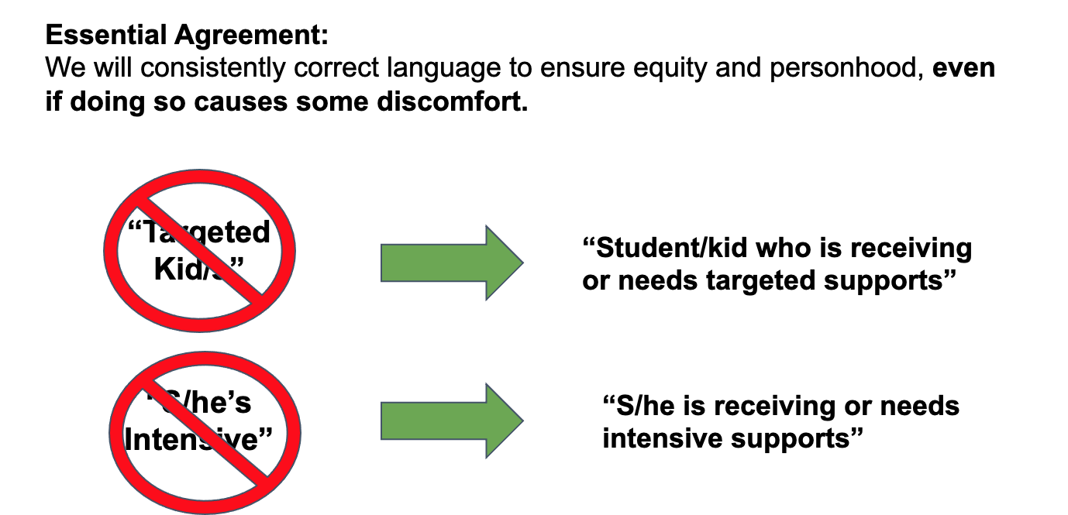
Label Supports, Not Students
Notes:
By using student first language, we are acknowledging that students can access different levels of support at different times, there will be many opportunities where we hear language that labels or categorizes students. It will be important to help our colleagues and ourselves to ensure that we are not contributing to a fixed mindset of students being something rather than receiving something.

Slide 21
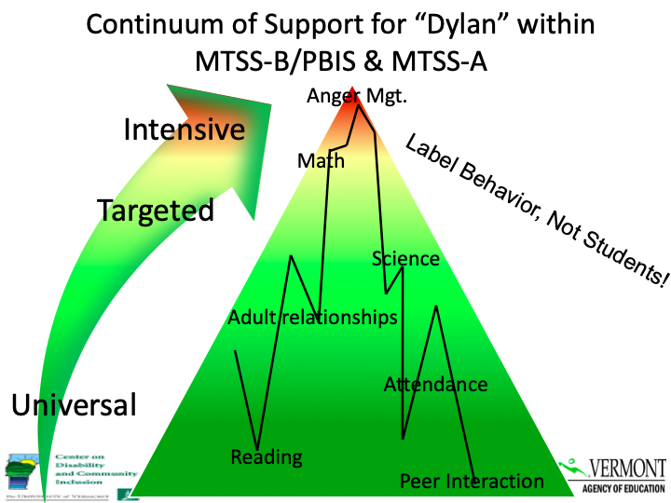

Slide 22
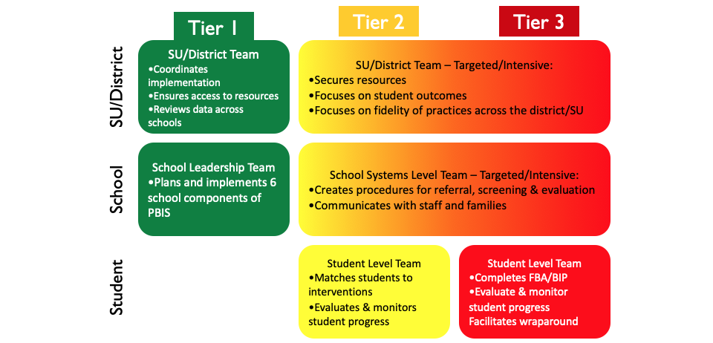
Necessary Conversations
Notes:
In order for students to move fluidly between levels of support, there has to be consistent conversation related to progress.
We are also going to assume that schools are maintaining all necessary conversations….Or Teaming effectively. Schools should be maintaining a Universal team that looks at school-wide data, trends, areas to focus on for teaching and practicing skills. A targeted team that has specific conversations related to the targeted school system of request for assistance as well as individual students and their progress.

Slide 23
Targeted Team Considerations
Access
Representation
Meaningful Participation
High Outcomes
Do we have staff capacity for two teams?
Can the team easily and effectively attend to both Targeted
(behavior) and EST (academic) needs?
Does EST have room on its agenda to meet Targeted systems and Targeted student planning needs?
Does EST meet frequently enough to provide rapid Targeted intervention response?
Is EST currently an effective & functional team?
If yes, would adding Targeted improve or interrupt?
If no, would it be better to:
bring Targeted structure into EST?
model effective systems & practices with separate Targeted team?
AOE EST Practices Doc

Slide 24
Tiered Fidelity Inventory (TFI) Tier II - TEAMS
2.1 Team Composition Tier 2 (or combined Tier 2 & 3) team includes a Tier 2 systems coordinator and individuals able to provide (a) applied behavioral expertise, (b) administrative authority, (c) knowledge of students, and (d) knowledge about operation of school across grade levels and programs.
2.2 Team Operating Procedures Tier 2 team meets at least monthly and has (a) regular meeting format/agenda, (b) minutes, (c) defined meeting roles, and (d) a current action plan.
2.3 Screening: Tier 2 team uses decision rules and multiple sources of data (e.g., ODRs, academic progress, screening tools, attendance, teacher/family/student nominations) to identify students who require Tier 2 supports.
2.7 Practices Matched to Student Need A formal process is in place to select Tier 2 interventions that are (a) matched to student need (e.g., behavioral function), and (b) adapted to improve contextual fit (e.g., culture, developmental level).

Slide 25
Questions to Consider
How can we ensure that Targeted interventions increase instructional opportunities, feedback, and positive home communication with students’ families?
How can we ensure that access to positive, instructional Tier 2 interventions is consistent across student groups?
How can we ensure that behavior concerns are being addressed to the fullest extent possible at Universal/Tier 1?
Notes:
Cassandra: I am wondering if this could be a break out discussion, an opportunity for them to work together on day 1, consider what they have in place, consider shifts/changes they may need to make to support tier 2?

Slide 26
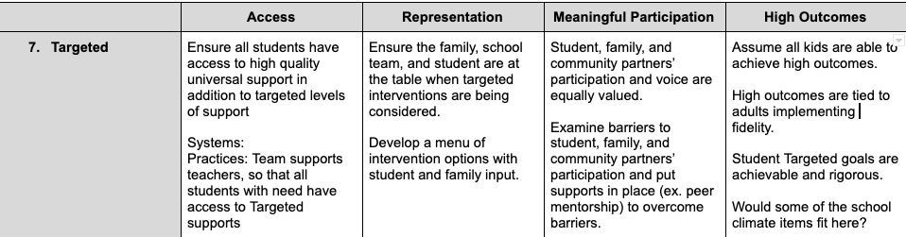
Activity:
Ensuring Equity at the Targeted Level
VTPBIS State Team Equity Crosswalk (2021)
Notes:
Activity here? Perhaps they evaluate their targeted systems and determine how to ensure equitable access? Have them report back any aha’s or big ideas.

Slide 27
Practices that Support Student Behavior
Supporting
Staff Behavior
OUTCOMES
Supporting
Decision Making
Data
Systems
Practices
Supporting Student Behavior
Notes:
3
SYSTEMS – we may need to shift our systems a bit to accommodate the needs of families and students post-pandemic. How can we beef up our universal supports or rethink the implementation of targeted supports for all students? We have to use our DATA (or anticipated data) to proactively keep many students who may be behind from exhausting our available supports or overwhelming referrals for special education.

Slide 28

Targeted Interventions
What are they?
When would you consider targeted supports?
What are the critical features?
Notes:
An intervention (or set of interventions) known by all staff and available for students during the school day.
Interventions provide additional student support in academic, organizational, and/ or social support areas.

Slide 29
What are Targeted Interventions?
Provide increased:
instruction & practice with self-regulation & social skills
positive & proactive adult supervision
opportunities for positive reinforcement
pre-corrections
focus on possible function of behavior
access to academic supports
Access
Representation
Meaningful Participation
High Outcomes

Slide 30
Targeted Interventions
What are they?
When would you consider targeted supports?
What are the critical features?
Notes:
An intervention (or set of interventions) known by all staff and available for students during the school day.
Interventions provide additional student support in academic, organizational, and/ or social support areas.

Slide 31
Which Students Might Need Targeted Level Supports?
Possible Categories of Risk:
Multiple disciplinary referrals
Attendance/late to school
Frequent nurse visits
Homework not completed
Behavior concerns not addressed through discipline system (e.g. social withdrawal, internalizing)
Other
Notes:
Most common review for eligibility is to look at ODRs. However, other “screens” for determining targeted interventions include academic stats, nursing visits, attendance, etc. Also, if you are worried about a students due to withdrawal or change in affect, the student might benefit. The idea, however, is to match intervention with student need.

Slide 32
Activity: How do you identify students in need?
How do you currently identify students who need additional supports?
What data/criteria is used?
How do staff know about the different options of interventions for students?
How do families know about the different interventions?
Notes:
What is currently in place in your school and what might need some strengthening?

Slide 33
Tracking Indicators of Risk Using Existing Data
Student | GPA | Course Failures | Days Absent | ODRs
Naama | 3.1 | 0 | 2 | 0
Tyree | 4.1 | 0 | 0 | 0
Cole | 2.8 | 1 | 0 | 1
Kyra | 1.4 | 3 | 11 | 12
Xochitl | 3.5 | 0 | 3 | 0
Jaxon | 1.9 | 1 | 5 | 7
EST Data Points Sample

Slide 34
Tracking Positive Behavior Expectations
Student | ODRs | Be Safe | Be Kind | Be Responsible
Naama | 0 | 3 | 3 | 2
Tyree | 0 | 3 | 2 | 3
Cole | 1 | 3 | 3 | 3
Kyra | 12 | 1 | 3 | 2
Xochitl | 0 | 3 | 2 | 3
Jaxon | 7 | 2 | 3 | 1
Notes:
School created simple 3-point scale for each of the school-wide expectations
Teachers given instructions for rating students and they provide overall rating to each expectation
How would this work in your school?

Slide 35
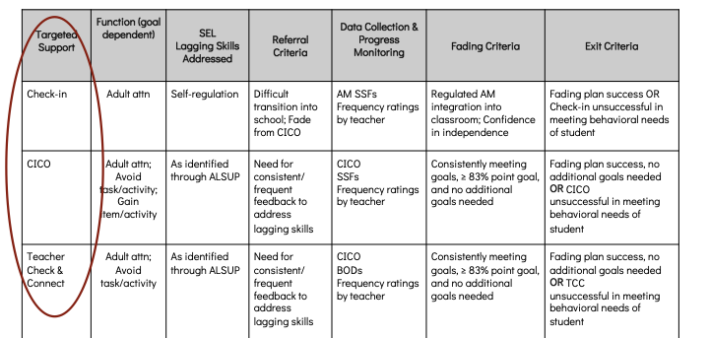
Targeted Inventory
Notes:
A targeted inventory can assist your teams identifying what types of data you may want to use to identify students

Slide 36
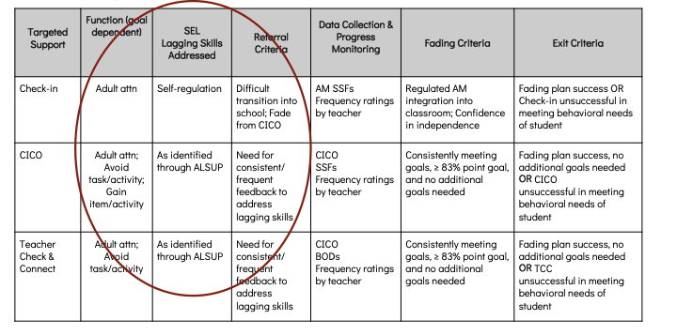
Targeted Inventory
Notes:
What assessment or screening data is your school using that could be incorporated into your targeted inventory and part of your request for assistance?

Slide 37
Targeted Interventions
What are they?
When would you consider targeted supports?
What are the critical features?
Notes:
An intervention (or set of interventions) known by all staff and available for students during the school day.
Interventions provide additional student support in academic, organizational, and/ or social support areas.

Slide 38
Critical Features of Targeted Interventions
Match to function
Require a “request for assistance” process
Include criteria for success
Are voluntary
Involve all adults in the school
Team Checklist

Slide 39
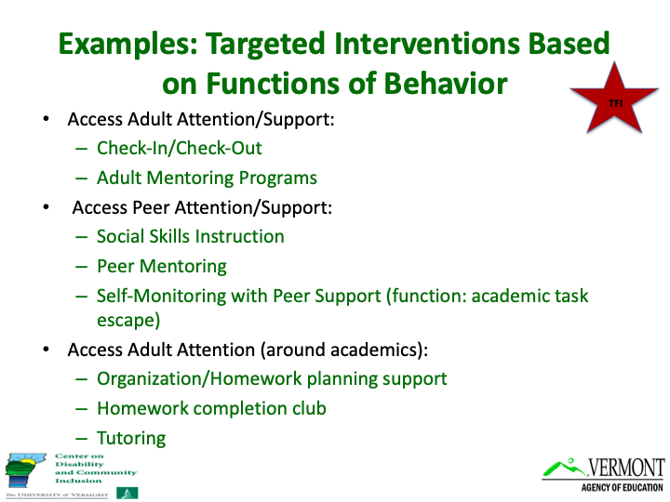

Slide 40

Choosing Interventions Based on Function
Targeted Support | Function (goal-dependent)
 | Adult attn | Peer attn | Avoid attn | Avoid task/activity | Gain item/ activity | Sensory
Check-in | x
CICO | x |  |  | x (goal dependent) | x
Earned Breaks | x | x | x |  | x
Recess Planning | x | x |  |  | x
Notes:
How do we choose an intervention? Well…
Do we close our eyes and throw a dart? No, we consider the data that shows indicators of risk, we use pre-determined cut-off for tier II interventions, and we match the student’s needs/lagging skills/function with the interventions.
Once you have chosen the intervention, you already know what the goals would be and how to track them. This was developed by the Target Level Systems team.

Slide 41
Inventory of Targeted Supports
Sample
Targeted Support | Function (goal dependent) | SEL Lagging Skills Addressed | Referral Criteria | Data Collection & Progress Monitoring | Fading Criteria | Exit Criteria
Check-in | Adult attn | Self-regulation | Difficult transition into school; Fade from CICO | AM SSFs Frequency ratings by teacher | Regulated AM integration into classroom; Confidence in independence | Fading plan success OR Check-in unsuccessful in meeting behavioral needs of student
CICO | Adult attn; Avoid task/activity; Gain item/activity | As identified through ALSUP | Need for consistent/ frequent feedback to address lagging skills | CICO SSFs Frequency ratings by teacher | Consistently meeting goals, ≥ 83% point goal, and no additional goals needed | Fading plan success, no additional goals needed OR CICO unsuccessful in meeting behavioral needs of student
Teacher Check & Connect | Adult attn; Avoid task/activity | As identified through ALSUP | Need for consistent/ frequent feedback to address lagging skills | CICO BODs Frequency ratings by teacher | Consistently meeting goals, ≥ 83% point goal, and no additional goals needed | Fading plan success, no additional goals needed OR TCC unsuccessful in meeting behavioral needs of student

Slide 42
Process for Requesting Assistance
Things to consider:
Who can refer a student for assistance (e.g. parent, teacher, self)
Is there a document to complete, a team meeting to attend?
How are decisions made regarding access?
Who maintains/updates data?
If the request is not met, what happens next?
Request for Assistance Team Checklist
Sample Nomination Form

Slide 43
Activity
How do you currently identify students that need additional supports?
What is your process for students getting connected to interventions?
How do staff know about the different options of interventions for students?
What works and what is challenging about the above?
We’ll ask one person from each team to share one strength/challenge
Notes:
I wonder if we could change these questions to reflect their interventions and potential addition of interventions rather than the process, which we are assuming is in tact before coming to this…Just a thought.

Slide 44

Another perspective
How do you currently identify students that need additional (academic) supports?
What is your process for students getting connected to (academic) interventions?
How do staff know about the different options of (academic) interventions for students?
What works and what is challenging about the above?
Notes:
Here’s the really direct connection between academic and behavior within a mtss.
I love this slide, but perhaps could be used in a different way?

Slide 45
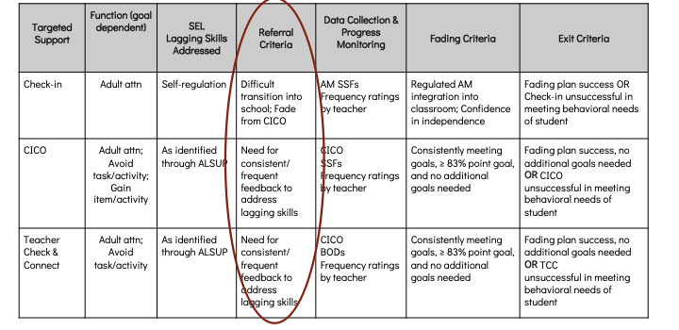
Request for Assistance/Referral Process
Notes:
ALSUP - Assessment of Lagging Skills and Unsolved Problems - Dr. Ross Green

Slide 46
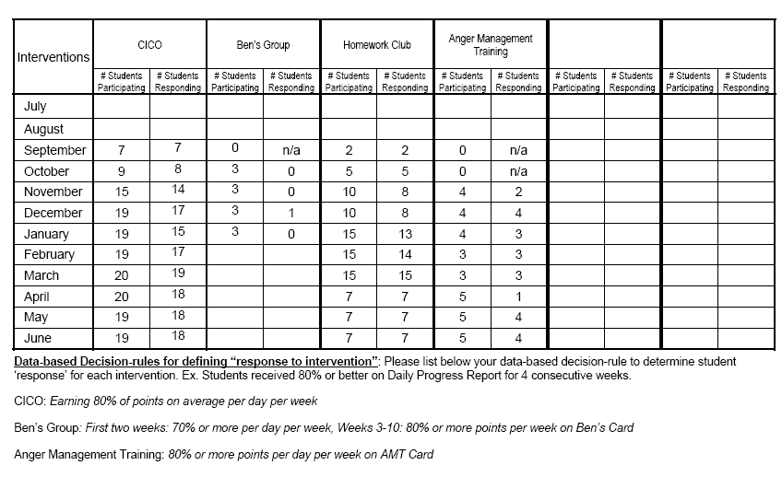
Targeted Practices Data Tracking Tool

Slide 47
Criteria for Success
What is your team hoping will improve or decrease as a result of the intervention?
What data will you collect to progress monitor
Who looks at the data?

Slide 48
Targeted Interventions are Voluntary
Things to consider:
How will interventions be discussed with students and families?
Who will review the intervention with the student?
What are some characteristics of the individuals doing check-ins that may encourage students to participate?

Slide 49
Securing Student Buy-in
Recommendations:
Available on a consistent basis
Has credibility with students
Positive and encouraging
Consistent demeanor
Knowledgeable of purpose for intervention and what to say

Slide 50

Remember...
Common misperception is that these strategies will “fix” the student and the classroom teacher does not need to be an active participant.
Targeted interventions will require involvement among ALL staff within the school building
Using your Zoom features, reply Yes or No.
Notes:
It is important that staff know what to be looking for in terms of progress to assist in celebrating with the student, staff can support progress in conversations with families, students can feel a sense of pride not just with a check-in person, but with any staff that connects with them regularly.

Slide 51
Quick Poll
When considering your school
and the targeted interventions in place,
do these interventions meet all core criteria?
Function of behavior is used to match student to intervention
Has a “request for assistance” process
Includes criteria for success or goals
Is voluntary
Involves all adults in the school
Notes:
Yes - Great work, you may be considering adding another intervention.
No - Keep working towards fidelity, implementation takes time.

Slide 52
Supporting
Staff Behavior
Supporting
Decision Making
OUTCOMES
Systems
Data
Practices
Equitable Outcomes for ALL
Supporting Student Behavior
Notes:
3
One research-based intervention, CICO, has proven to provide positive student outcomes when implemetnated with fidelity.

Slide 53
Key Features of CICO
Check in and out with a Coordinator at the beginning and end of day
Increased instruction and feedback on behavioral expectations with the teacher after each class/instructional routine through Daily Progress Report (DPR)
Parent/guardian provides positive feedback and encouragement to child at end of day
Student receives reinforcement when behavioral goals are met
pbisworld.com
Notes:
Research-based intervention
Evidence that school can successfully implement
Evidence of decreased problem behavior
Effective for 60-75% of students in need of Targeted supports
Less effective for students who do not find adult attention reinforcing, but research is promising!

Slide 54
CICO is All About Relationships and Connection!
Focus on providing reinforcement that involves time with adults or other students to build connections
Tangible reinforcers earned should always be paired with verbal praise/attention from adults
Support students needs by transitioning attention

Slide 55
Daily Progress Report (DPR) Sample
NAME:______________________ DATE:__________________
Teachers please indicate YES (2), SO-SO (1), or NO (0) regarding the student’s achievement in relation to the following sets of expectations/behaviors.
“Individualized Student Card linked to Tier 3 FBA/BIP"
EXPECTATIONS | 1 st block | 2 nd block | 3 rd block | 4 th block
Be Safe | 2 1 0 | 2 1 0 | 2 1 0 | 2 1 0
Be Respectful | 2 1 0 | 2 1 0 | 2 1 0 | 2 1 0
Be Responsible | 2 1 0 | 2 1 0 | 2 1 0 | 2 1 0
Total Points
Teacher Initials
Use your words
Use deep breathing
Keep arm’s distance
Use #2 voice level when upset
Ask for breaks
Self-monitor with DPR
Adapted from Grant Middle School STAR CLUB
Adapted from Responding to Problem Behavior in Schools: The Behavior Education Program by Crone, Horner, and Hawken
Notes:
55
Remember to review this in slide show so you can see that it is animated.

Slide 56
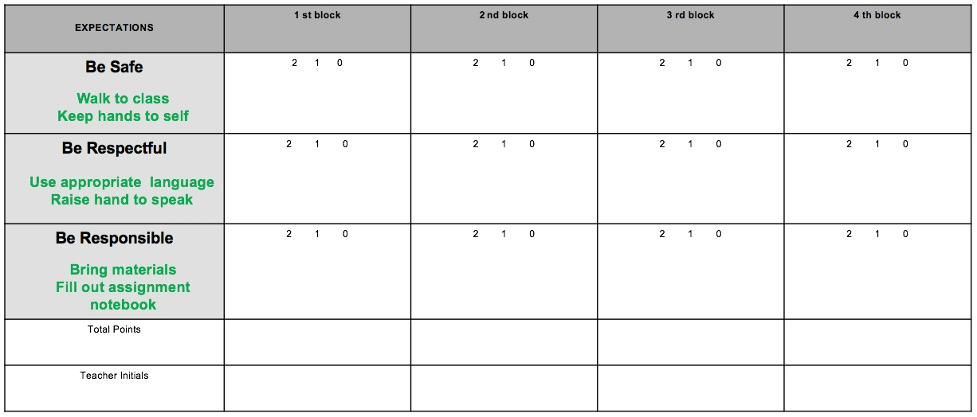
DPR for Social/Academic Goals

Slide 57
Other CICO Adaptations
CICO for School Arrival – “I’m here and ready to learn!”
CICO for Recess
CICO for Distance Learning
May need to change goal line from 80% to 50-60%
May check in daily with a Google form – “How do you feel?” “Are you ready for learning?”
Checking in and checking out with different adults – teacher, other adult, family member
Checking in at different intervals
What else?
Notes:
Distance learning - Work completion
Engaging in virtual environment without interrupting/disrupting others
Showing up for virtual learning/attendance
Participating in learning and social interactions
Checking in and out with family member

Slide 58
Activity
In your breakout groups:
review the CICO Enhancements worksheet
discuss the questions at the top of the worksheet
Identify one thing you or your team would like to try
Identify one question or roadblock you may experience
Notes:
Sherry

Slide 59
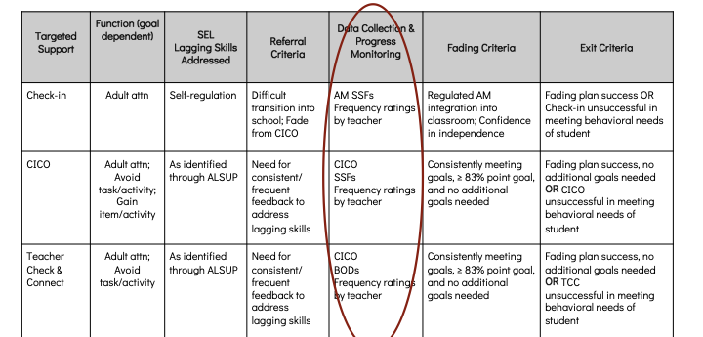
Targeted Inventory

Slide 60
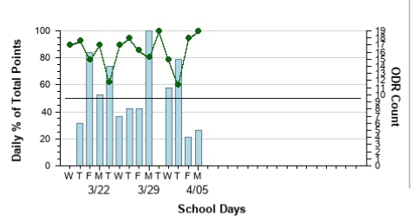
Individual Student Data Monitoring

Slide 61

Data help us ask the right questions. They do not provide the answers.
Notes:
Assess current status and fidelity of implementation (school-wide)
Assess impact on students
Prioritize areas for change
Acknowledge incremental success along the way
Show staff you value and use their input to make changes (SAS)
Reward staff and student performance
Determine breaks between “roll-outs”
Share results with stakeholders

Slide 62

Exiting Students from Interventions
Celebrate accomplishments
Provide reminders that everyone needs help sometimes
Do not “graduate” in case they need assistance in the future

Slide 63

Intervention Success
Some things to consider if interventions are not working:
Staff Training
Fidelity of implementation
Lack of buy-in/support from staff
Contextual fit (i.e. developmental level)
Identified function
Notes:
Another question to consider if you have all of the components in place is are these interventions successful?
If not, here are some things to consider.
Fidelity - the degree to which the intervention is delivered as intended. Research tells us that this significantly improves student outcomes. An example might be, if a student’s identified function is adult attention and they have a CICO, are they happening at the right time and consistently?
Lack of buy-in - I had a teacher who refused to circle the points for a child after their class so the para was doing the circling but had not been trained on definitions and criteria which resulted in inconsistencies and lack of buy-in from the child.
Administrators are a key piece in intervention success - carving out time for resources to be available, making certain there is a back-up plan, and speaking regularly to the impact interventions have on student success.
Contextual fit is important - do the interventions match the school environment. Are the interventions in line with your school-wide expectations and your goals for that child.

Slide 64
Activity
In your Breakout groups:
Identify one of the following areas that may be impacting Targeted success
Staff training (what is it, why do we use it, how do we do it)
Fidelity of implementation
Lack of buy-in/support from staff
Contextual fit (i.e. developmental level)
Identified function is addressed
Problem-solve ways to support improved success

Slide 65
Expanding Targeted Supports
Check-in
CICO with identified goals
Teacher Check and Connect
Self-Regulation - Gear Up, Mindfulness Breaks
Earned, Scheduled, and Processing Breaks
Lunch Groups
Recess Planning
Social Skills or Confidence Boosters Groups
Mentoring
CICO Enhancements Worksheet

Slide 66
Additional Interventions
Resiliency Ed Program
Zones of Regulation as Targeted
Mood Meter
RULER
SEL as Targeted (Second Step)
Behavior Contracts
Delta
Recess reset
Behavior Doctor activity
What else?

Slide 67
Data for Decision Making
Supporting
Staff Behavior
OUTCOMES
Supporting
Decision Making
Data
Systems
Practices
Supporting Student Behavior
Notes:
3
SYSTEMS – we may need to shift our systems a bit to accommodate the needs of families and students post-pandemic. How can we beef up our universal supports or rethink the implementation of targeted supports for all students? We have to use our DATA (or anticipated data) to proactively keep many students who may be behind from exhausting our available supports or overwhelming referrals for special education.

Slide 68

What types of data do you use to identify students in need of supports?
Mentimeter.com
Notes:
Cassandra - this link will take you to the word cloud. Each participant can enter up to 3 different types of data.

Slide 69
Types of Data to Consider
Intensive:
TFI
I-SWIS
EST
FBA/BSP
Targeted:
TFI
SWIS-CICO
EST
FBA/BSP
Universal Screening
Universal:
TFI
SAS
SWIS
Attendance
Grades
Leadership Team Self-
Assessment
School Climate
Family Engagement
Notes:
What else?
All data should serve a purpose
Collect data with fidelity
Be prompt about looking at data and acting upon it
Use multiple sources of data to confirm what you see
Use data to support, not punish

Slide 70
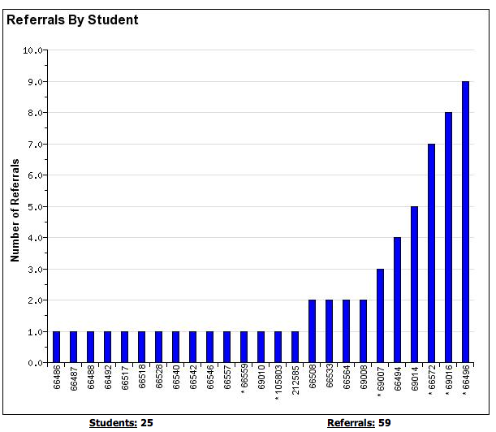
Using Behavior Observation Data (formerly ODR’s)
Using the Referrals by Student report as a Universal Screening Tool
Notes:
Green Circle to remind all participants that while a student may be receiving targeted or intensive interventions, all students still have access to universal supports!

Slide 71
Consider Universal Screening
Early identification of students at risk of school failure due to social, emotional and/or behavior problems.
Mechanism for targeting students who need additional supports after receiving evidenced-based universal behavior supports (PBIS).

Slide 72
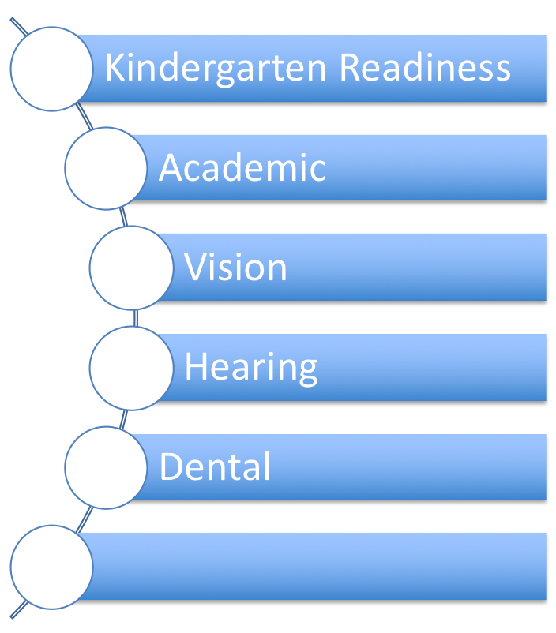

Ways schools use Universal Screeners to inform practice….
Why not?
Notes:
Consider Universal Screening!
Ask and connect: what types of universal screeners do people use for academics?

Slide 73
Why Universal Screening?
To find students whose problems are not immediately obvious.
To identify problems with a high degree of accuracy.
Early identification leads to early intervention.
To select interventions based on results of rating scales on the screening tools. This is most effective and efficient.
Notes:
As we already said, we’re doing a multitude of screenings in schools anyway. Just like with our other screenings, early identification leads to early intervention. Using formalized screening measures allows schools to select interventions that are based on results of rating scales rather than guesses.
Screening allows us to be objective.
Matching interventions to what is going on with the student. A simplistic example would be supporting a shy, withdrawn student with a standard CICO intervention
Academic Success is linked with social and behavioral skills
Early identification with intervention can decrease the likelihood of academic failure
Preventive supports reduce the need for more intensive supports later

Slide 74
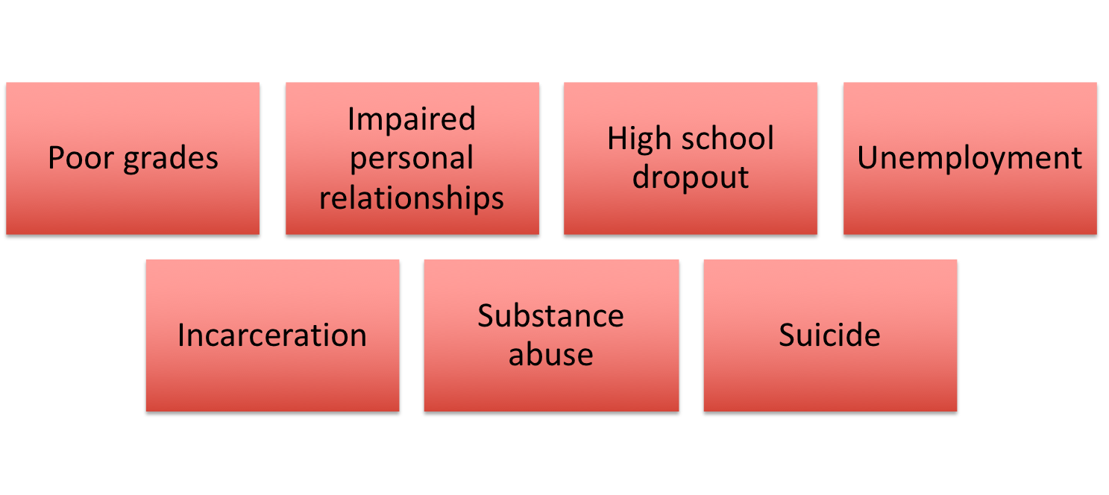
Poor Outcomes for Unidentified and Untreated Youth
Notes:
More students labeled EBD are not eligible for special ed (1% nationally).
But EBD still have needs must be identified and addressed for academic success.
“Untreated emotional problems have the potential to create barriers to learning that interfere with the mission of schools to educate all children.” (Adelman & Taylor, 2002)
“Without early intervention, children who routinely engage in aggressive, coercive actions, are likely to develop more serious anti-social patterns of behaviors that are resistant to intervention.” (Walker, Ramsey, & Gresham, 2004)
Youth who are the victims of bullying and who lack adequate peer supports are vulnerable to mood and anxiety disorders (Deater-Deckard, 2001; Hawker & Boulton, 2000)
“Depressive disorders are consistently the most prevalent disorders among adolescent suicide victims (Gould, Greenberg, Velting, & Shaffer, 2003)
.

Slide 75
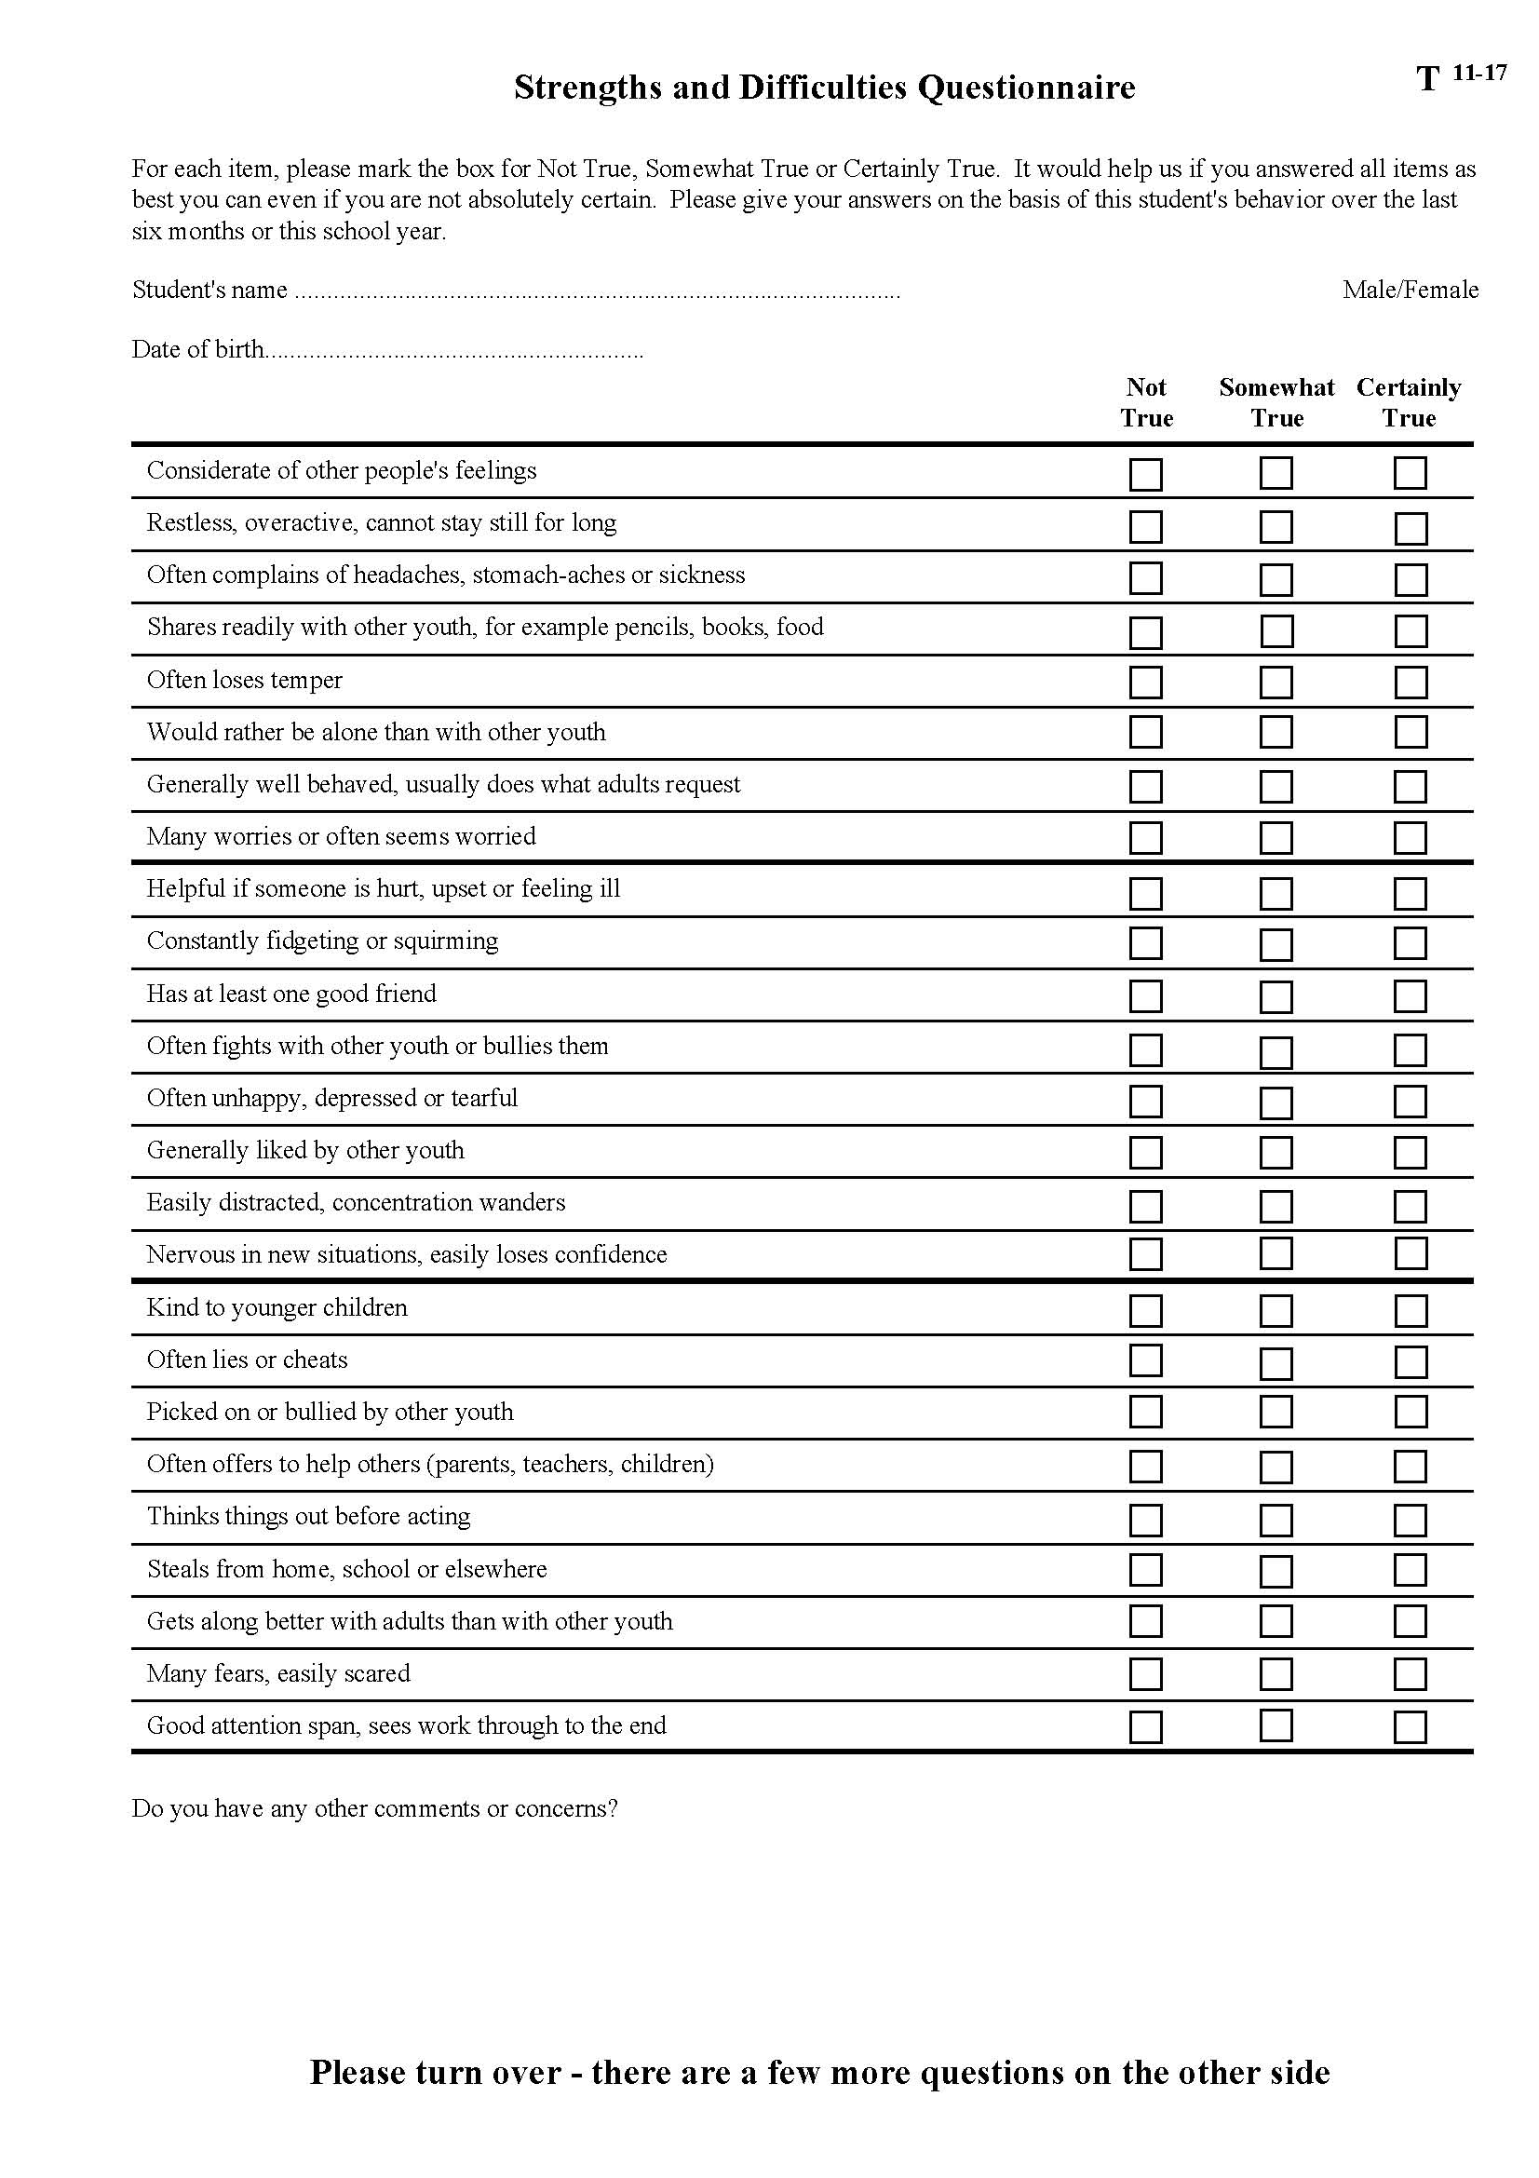

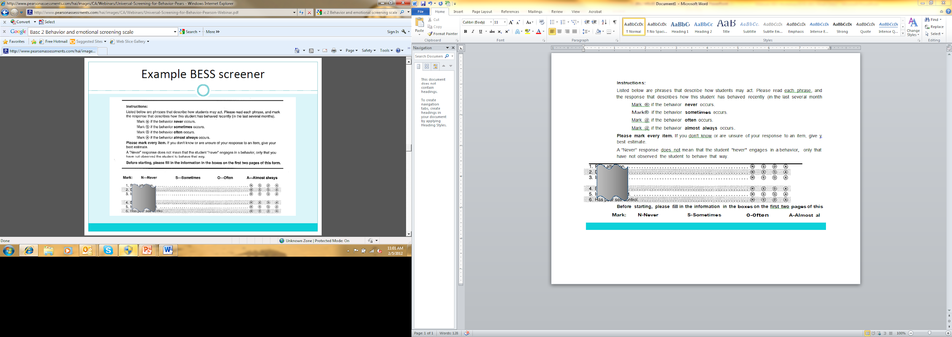
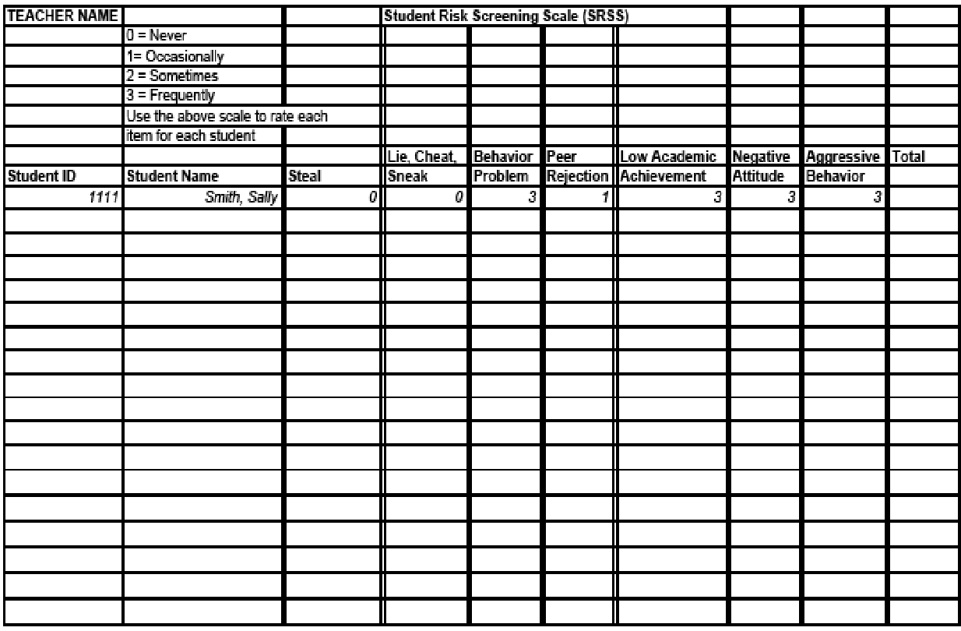


Formal Screening Tools
See Lane, Menzies, Oakes, and Kalberg (2012)
Notes:
SSBD – Ssystematic Screening for Behavior Disorders
Basc 2 BESS
Strengths and Difficulties Questionnaire
SSIS – Social Skills Improvement System
SRSS – Student Risk Screening Scale – FREE?

Slide 76
More on Screening
Want to learn more?
http://www.ci3t.org/screening
Notes:
This would be a really good site to explore during team time in the afternoon.

Slide 77

What could your team focus on for improvement?
Address function of behavior
Continuously available
Quickly and easily accessed
Consistent with school-wide expectations
Require minimal extra effort by teachers
Identify goals
Monitor progress
Includes student voice
Use school resources creatively
Implemented with fidelity
Notes:
Implementing a tiered system of supports is hard work and requires lots of discussion, self-reflection, and tweeking. Don’t give up!
You can use this as a checklist for supporting your efforts moving forward.

Slide 78


Slide 79

Thank you!

