Slide 1
Strengthening Your Continuous Improvement Planning
Day One
Notes:
Josh

Slide 2
Welcome
First Branch Elementary School
First Branch Middle School
Rochester School
North Country Union Junior High School
Notes:
Josh

Slide 3
Housekeeping
Take care of your personal needs
Bathroom locations
Breaks
Strand times
Exit cards
Notes:
Josh

Slide 4
Day One Agenda
Overview of Comprehensive Needs Assessment
High level overview of Plan-Do-Study-Act (PDSA)
PDSA Activity
Improvement Projects
Homework and Exit Tickets
Notes:
Josh

Slide 5
Day Two Agenda
What we heard from exit tickets
Plan - Data and Root Cause/Causal Analysis
Plan – Problem of Practices and Clear Measurable Goals
Activity
Homework and Exit Ticket
Notes:
Josh

Slide 6
Day Three Agenda
What we heard from Exit Tickets
Evidence-Based Practices and Change Ideas
Data/Measurement Plans
Activity
Homework and Exit Ticket
Notes:
Josh

Slide 7
Day Four Agenda
What we heard from Exit Tickets
Time to complete Improvement Project
Presentations
Notes:
Josh

Slide 8
Learning Objectives
By the end of this strand, participants will have learned how to:
Implement the Plan-Do-Study-Act (PDSA) process to work with their own school-level data to determine root causes
Learn how to find evidence-based practices
Create clear and measurable goals
Determine fiscal resource options to support the implementation of required Safe and Healthy School goals that address improving student outcomes related to behavior, social-emotional learning, and academic outcomes.
Notes:
Josh

Slide 9
Introductions
Beach Ball Activity
Toss the beach ball to someone in the room
The person who catches/retrieves the beach ball states their name, school they’re from, occupation, how many times have you attended BEST, what do you hope to take away from this strand, answer question closest to your right thumb
Then toss/pass the beach ball
Notes:
Josh

Slide 10
Introductions and More
Name
School
Occupation
How many times have you attended BEST?
What do you hope to take away from this strand?
Answer question closest to your right thumb
Notes:
Josh

Slide 11
Questions
Notes:
Josh

Slide 12
Comprehensive Needs Assessment (CNA)
Overview
Definition & Purpose
Stages
Resources
Notes:
Toni – I am now going to provide you with an overview of the comprehensive needs assessment or the CNA. There are three intended outcomes for the overview of the CNA, the first to understand the purpose of a comprehensive needs assessment, particularly as it relates to continuous improvement planning. Second to be able to identify the four main stages of a comprehensive needs assessment and gain familiarity with some specifics of each, and third, introduce a few resources to support conducting comprehensive needs assessments and the continuous improvement process in general in your schools or LEA's

Slide 13
CNA Definition and Purpose
First step in any improvement planning
Establish a culture of reflection and learning
Notes:
Toni –
So, what is the CNA process and what does it consist of?
What is it?
The comprehensive needs assessment process serves as a first step in continuous improvement planning.
It is a process of analyzing data about a school or school system to learn what has occurred, is occurring and needs to occur to improve student outcomes (Bond & Sodat, 2016).
The comprehensive needs assessment process leads to the identification of specific and measurable goals for improvement and high-leverage change ideas to achieve them.
And – a comprehensive needs assessment establishes a culture of reflection and learning (mintrop, 2016)

Slide 14
Definition and Purpose
Notes:
Toni - Think of a comprehensive needs assessment this way…. sometimes we go to the grocery store without looking in the fridge or in the cupboard. We don't pull out any recipes and we don't make a list. How's that usually turn out? We wander the aisles, we take a guess at whether we need milk, we forget a couple of things, grab some odds and ends, and chances are we'll be back at the grocery store soon.
On the other hand, if we take an inventory of the food that we have in the house, plan some meals, and have a list to guide our shopping, our trips to the store turn out a lot differently. We shop efficiently and we end up with a cart full of things that we need. Preparing for improvement through a comprehensive needs assessment is a lot like going to the grocery store with a list . If we're going to take the time, expend the energy, and spend the money we should make sure that we're getting what we need, especially with student learning on the line.

Slide 15
Stages of the CNA Process
Preparing for Collaborative Inquiry
Identifying priority Problems of Practice
Analyzing Root Causes
Determining Ideas for Change
Notes:
Toni - Conducting a comprehensive needs assessment is a systematic but flexible process, consisting of these essential steps:
First, teams prepare for collaborative inquiry by assembling a needs assessment team, establishing common understandings of school or school district beliefs and goals, and conducting a broad overview of their data.
Next, teams refine their needs assessment by focusing their work on specific areas of the data arriving at priority problems of practice.
From there, teams analyze root causes identifying the essential system components and practices or drivers that are having the greatest impact on their problems of practice.
And finally, the team writes specific goals and determines change ideas to pilot and ways to measure whether these innovations are leading to improvement.
Now, lets explore these stages in a bit more detail.

Slide 16
Preparing For Collaborative Inquiry
Have we included representatives from stakeholder groups, with diverse perspectives?
What are our shared beliefs and goals for our students and schools?
What data is available to us, and what additional data do we need?
Notes:
Toni - The first step in preparing for collaborative inquiry is to assemble a group of stakeholders to collaborate with.
A comprehensive needs assessment can be conducted by a pre-existing team though additional participants or input might be sought to represent as much of the school community as possible. School staff, students when appropriate, parents, administrators, school board, and community members each bring unique and important perspectives to the process.
Next, the team develops or revises a shared vision to guide your work. A shared vision is a written statement of your team's common beliefs and goals for school and student outcomes. If your school or district already has a shared vision, this step might just involve introducing it to your stakeholders, checking for agreement, and possibly making minor revisions. If a shared vision doesn’t exist, beginning the CNA process is a good reason to write one. The shared vision can then serve to steer your needs assessment toward those priorities.
Finally, the process of identifying specific goals and change ideas for improvement begins by assembling a broad overview of school system or school level data representing a wide range of practices and outcomes.

Slide 17
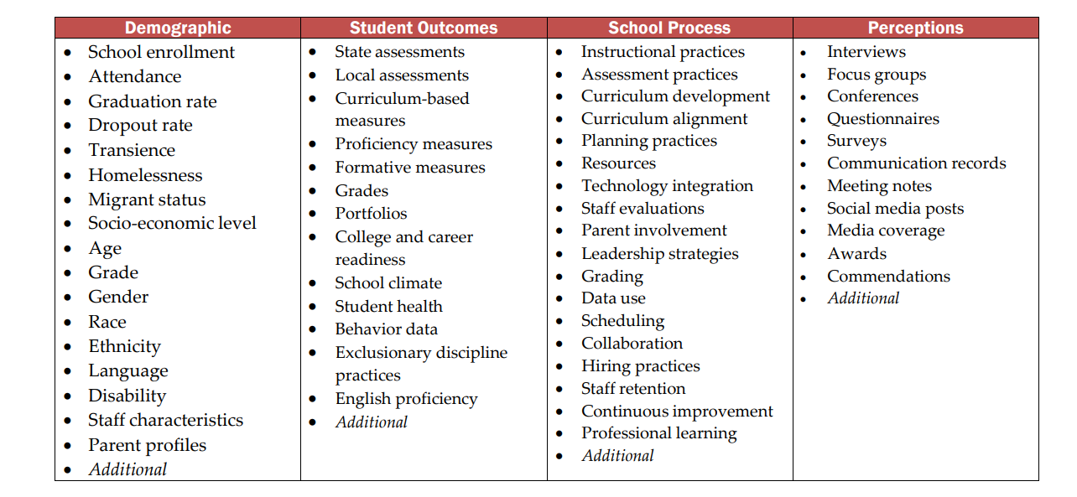
Preparing for Collaborative Inquiry – Sources of School Data
Notes:
Toni –
Most schools and LEAs collect four types of data: demographic data, student outcomes, school process data and perceptions data.
Demographic data includes enrollment rates, retention rates, gender, race, ethnicity, disability, income, graduation and dropout rates.
Student outcomes data includes results of state and local assessments, curriculum based-measures, demonstrations of proficiency, formative measures, behavior and social-emotional health
School Process data includes measures of instructional practices, continuous improvement, curriculum alignment, professional learning, staff evaluation, resource availability, technology integrations, and program effectiveness
Perceptions data includes climate surveys, communications data, parent and community involvement data, and focus groups.
Once you have compiled and analyzed data from these multiple sources, you can begin to identify trends, assets and challenges across the system, as well as understand where and why variation is occurring.

Slide 18
Identifying Problems of Practice
In what general area(s) are out outcomes not meeting shared expectations?
What discrepancies, patterns or trends within this focus area do the data reveal?
What unmet student needs have we uncovered, and which are the most important to address?
Notes:
Toni –
The second stage in conducting a comprehensive needs assessment is identifying problems of practice beginning with the selection of focus areas. Focus areas are general areas of need revealed during the broad data overview and provide an initial direction for a deeper data analysis.
Let's use lagging science outcomes over the past three years as an example. With a focus area or areas agreed upon the team identifies and collects additional data related to this area as needed. From there the team makes factual observations about the data. The observations should be free of assumptions or biases describing indisputable points, discrepancies patterns, or trends in the data. Once you have a clear picture of the facts revealed by the data move on to making inferences about what these facts are telling you.
When sufficient data has been collected, observations made, and inferences drawn, a problem of practice within the focus area is identified. In the case of our science outcomes focus, let's say that scores in the discipline of physical sciences have been noticeably lower than in other areas. In the light of time and resource limitations it's often necessary for teams to prioritize their problems of practice. When prioritizing problems of practice ask yourselves which unmet student needs have we uncovered, and which are the most important to address.

Slide 19
Analyzing Root Causes
Which system components and practice potentially influence this problem?
Which system components and practices likely have the greatest influence on this problem?
What are the fundamental reasons (Root Causes) for the current states of these system components or practices?
Notes:
Toni –
With a problem of practice identified, the team will dig further into the data through a root cause analysis. This process begins by proposing and prioritizing drivers. Drivers are the components of the system believed to have influence on your problem of practice. Identifying these factors can be based on research or experience supported by local data.
From our example, what aspects of the system might be impacting the teaching and learning of physical sciences? Some examples might be aspects of the curriculum, teacher content knowledge, or student interest. Once all ideas are on the table, the team should prioritize those drivers that they believe are having the greatest influence.
Let's prioritize student interest based on conversations with some of our kids. With a priority driver chosen, ask why the current state of this driver exists. Until the fundamental cause or the roots have been reached, why a student interest low could it be a lack of past exposure, perceive difficulty of the material, the absence of real-world context for their learning. Asking these questions, then generating data to uncover their answers will lead you to the root causes of your problem of practice.

Slide 20
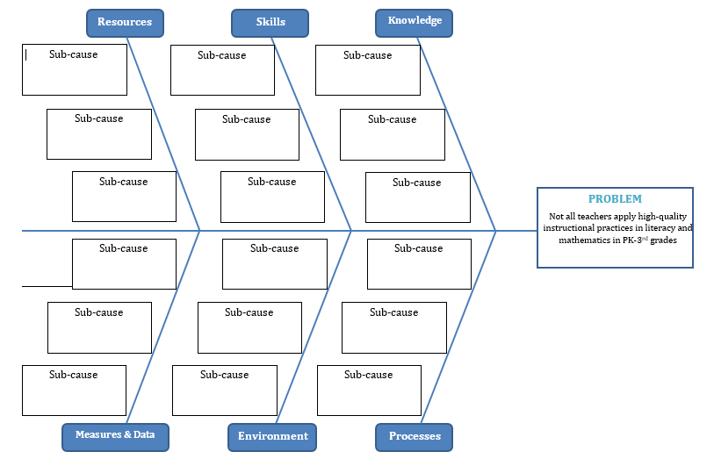
Identify Underlying Systemic Causes of Challenges
Fishbone Diagram
Five Why’s Worksheet
Vermont Continuous Improvement Website
Notes:
Toni - As you are summarizing the challenges, you can use a root cause analysis/cause and effect diagram (the fishbone or 5 whys) to uncover and confirm the underlying root causes of challenges or problems of practices, to ensure that you are solving the right problem.
These tools are in the Comprehensive Needs Assessment Toolkit on our Continuous Improvement website to help you facilitate this process.

Slide 21
Sample Root Cause Analysis
Notes:
Toni - Here is a sample causal analysis, or fishbone diagram.
The stated problem of practice appears at the top (or the head of the fishbone diagram). In this case it is “some systems, processes, and /or practices in Mathematics/Literacy are not meeting the needs of many students because…
The major causal categories related to this problem of practice include curriculum, instruction and assessment, culture, and system coherence and consistency.
Some of the root causes, across these categories include inconsistency and incoherence in instructional practices, educators lacking the necessary content or pedagogical knowledge, insufficient rigor in the curriculum to match expectations, variation in educator expertise and qualifications, and weak home-school alignment and partnerships.

Slide 22
Planning for Change/Developing a Theory of Improvement
By June of 2027, we will increase the average seventh-grade sub score in the discipline of physical sciences by 20% on the state science assessment.
Notes:
Toni - When planning for change the team transforms their priority problems of practice into a goal statement that represent the desired outcome for improvement. Goals for improvement should be specific and measurable describing WHAT will be improved, by HOW MUCH, by WHEN, and for WHOM, or in what settings.
EXAMPLE: For example, by June of 2027 we will increase the average seventh-grade sub score in the discipline of physical sciences by 20% on the state science assessment.
Drivers are the various components of the system believed to have the greatest influence of your goal. Drivers can be primary (greatest influence on the goal, for example, communication, instructional practices. And then you have Secondary drivers, which are specific practices within the primary driver, such as digital platform use or need for added rigor. Collectively, drivers represent a conceptual pathway form your goal to your chosen change ideas.
If you've successfully identified the root causes of problem of practice, a goal to address the problem of practice, and identified drivers, proposing logical change ideas becomes straightforward.
Typically change ideas originate in three places, research knowledge practice knowledge, and through the design of new ideas.
What's one change idea that a team could pilot to increase student interest in physical sciences? How about an annual physical sciences fair having an opportunity for student driven project-based learning. Now, to determine the effectiveness of a change idea it's essential that you not only have a clear measurable goal for success, but also methods to assess progress formatively and to monitor for unintended consequences along the way.
Now, to determine the effectiveness of a change idea it's essential that you not only have a clear measurable goal for success, but also methods to assess progress formatively and to monitor for unintended consequences along the way. Three measurement types – Outcome measures, process measures, and balancing measures, can be used to maximize the effectiveness of your team's continuous improvement efforts.
Outcomes measures measure the intended results of your change idea. In the case of our example, an increase in student interest in the physical sciences, a pre-and-post survey of fair participants would be one way to measure this.
Process measures are used to determine whether the successful implementation of a change idea is occurring before the outcomes are known. This can serve to drive decision-making before outcome data is available. Examples of a process measure for implementing an instructional strategy might include: a protocol checklist after each class, teacher survey/interview, or coaching feedback logs.
And finally balancing measures are used to test for unintended consequences of improvement. We use balancing measures with appreciation for the complexity and interconnectedness of our system. In our example, if student time and energy are spent on a preparing for a physical sciences fair, an interest in physical sciences is growing will students be less likely to participate in the early code night while working.

Slide 23
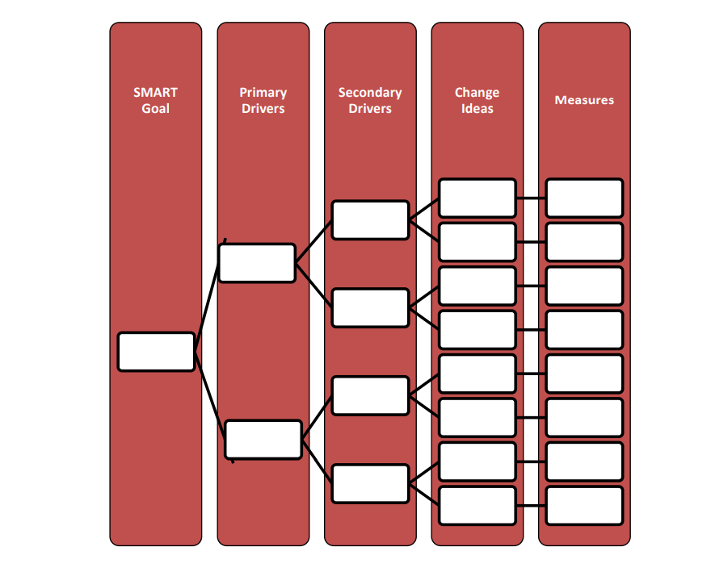
Developing a Theory of Improvement
Driver Diagram
Writing a Theory of Action Statement
IF we implement (change idea), THEN, (impact on secondary driver), THEN (impact on primary driver), THEN (goal).
Notes:
Toni - The driver diagram is a method for organizing your theory of improvement and can be completed using the information collected during the comprehensive needs assessment process. It becomes a record of learning and a roadmap for intervention. Theories can change as you team tests each change idea and learns from the experiences.
A driver diagram shows the relationship between the goal of your improvement project, the primary drivers that directly relate to achieving the goal, the secondary drivers that are components of the primary divers, and specific change ideas to test for each secondary driver.
Through the stages of a comprehensive needs assessment your team will gain increasingly specific insight and the improvement needs of your school or school system.
This collective learning is used to create a theory of improvement. A theory of improvement describes the structures and processes that the team believes will need to be changed to meet an improvement goal, as well as specific actions to create these changes.
When using the driver diagram to write a theory of improvement/action statement, you should work from right to left, starting with the change idea and ending with the goal, the statement should be written using an “if… then…
For example, If we implement (Change Idea), THEN, (impact on secondary driver), THEN (impact on primary driver), then (goal).

Slide 24
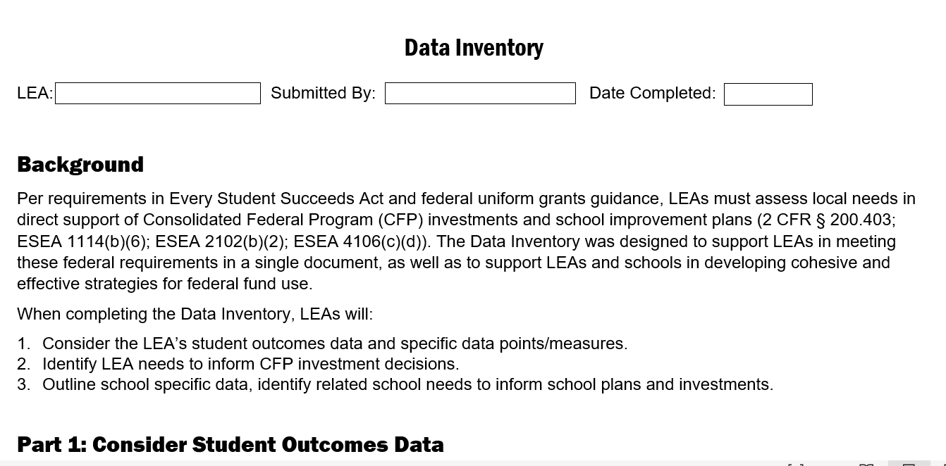
Data Inventory
Record findings of your Comprehensive Needs Assessment
Support from EQC and CFP team
Notes:
Toni - As you complete the data analyses in your needs assessment, you will record your findings in the Data Inventory. The EQCs and CFP team can support you in completing this template.

Slide 25
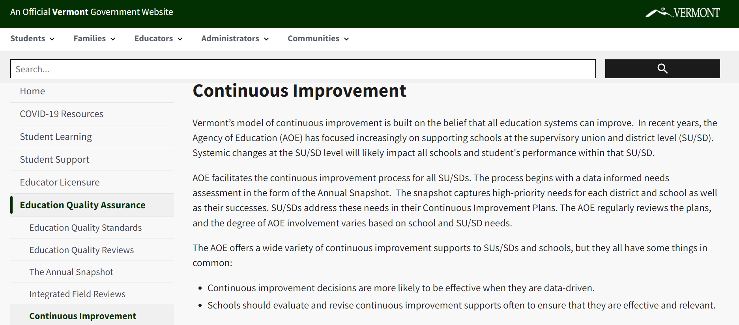
Resources - Continuous Improvement Framework, Toolkits, and Templates…
https://education.vermont.gov/education-quality-assurance/continuous-improvement
Notes:
Toni – A variety of toolkits and resources are available on our Continuous Improvement webpage to assist you in your continuous improvement efforts. Some of the resources include:
the comprehensive needs assessment toolkit, which contains details on the processes we overviewed this morning,
a PDSA cycle toolkit, which you can use during the implementation of your CIP change ideas,
The site also contains instructions for CIP submission and the CIP template
And others.
The Education Quality Assurance team is here to support you in your continuous improvement efforts and in the development of your continuous improvement plans so reach out to us at anytime. Thanks!

Slide 26
Break time!
Notes:
Josh

Slide 27
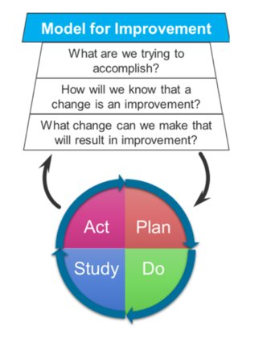
Overview of PDSA
Notes:
Lori for 20 min overview of PDSA (rest of time to Josh for activity)

Slide 28
Sample Current state (from disaggregated EL data analysis):
Demographic Data
Increased enrollment of students qualifying for EL services
High rate of absenteeism for EL students, overall
Student Learning Data
Disaggregated data show significant gaps in proficiency between EL and non-EL student populations
On local & state assessments 10% of EL students in grades K-3 are proficient in reading standards
School Process Data
Drastic reduction in interventionists and specialized support staff
Education Support Team is lacking representation and not meeting regularly
Current curriculum & instructional practices have limited foundational skills instruction and intervention models and do not include considerations/strategies for EL students
Perceptions Data
Low participation on parent surveys/focus groups & data reveal many newly arrived families
Teachers report low confidence levels in applying Science of Reading (SOR) practices with all students

Slide 29
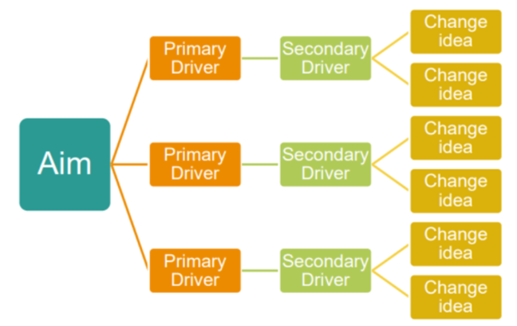
Model for Improvement
Clear Measurable Goals/Aims

Slide 30
Setting Clear, Measurable Student Learning Goals
Quality Aim/Goal statements include these components:
What? (operationalize the specific skill/process/practice that is being improved?)
For whom? (who is the intended population?)
By when? (when do you expect outcomes to be achieved?)
By how much? (to what degree will improvement/progress be made by that time?)
Are goals specific to reasons for identification?
e.g., By June 2024, 90% of K-3rd grade English Learners are reaching proficiency in grade level reading fluency, as measured by Decoding Inventories & Oral Reading Fluency Assessments.
e.g., By June 2024 we will reduce the math/literacy performance gap for English Learners and their peers by 20%
Notes:
Setting clear, measurable student learning goals entails 4 basic criteria (what, for whom, by when, and by how much). The What component operationalizes the specific skills/processes/practices that are being improved? The For whom component identifies the intended population for whom the goal is set? The By when component identifies when you expect outcomes to be achieved, and the By how much? Component indicates the degree of improvement you expect will be made by that time. Basically, you want to be explicit about the intended outcome & What evidence will show that students have achieved the aim. So, If someone checked back in later in the year, what would they be expecting to see (is that clear in the goal/aim statement)?

Slide 31
Identify Underlying Systemic Causes of Challenges
Problem of Practice: Most of our English Learners in grades K-3 are not meeting reading proficiency levels
Vermont Continuous Improvement Website
Notes:
As you are summarizing the challenges, you can use a root cause analysis/cause and effect diagram to uncover and confirm the underlying root causes of challenges or problems of practices, to ensure that you are solving the right problem. We have tools in the Comprehensive Needs Assessment Toolkit on our Continuous Improvement website to help you facilitate this process. A sample causal analysis is included on the following slide.

Slide 32
Sample Causal Analysis
Potential causes:
Newly arrived families with very little experience in using English language
Absenteeism is limiting exposure to instruction
Lack of strong systematic phonics instruction in early grades
Insufficient time with practicing (reading and fluency exercises)
Minimal if any small group instruction & interventions
Inconsistency with instructional and intervention practices
Lack of structure from EST
Teacher confidence in content knowledge & pedagogical practice in SOR

Slide 33
Model for Improvement and EB Change Ideas
Evidence-based Change Ideas

Slide 34
Change Ideas
Operationalize for Implementation:
Can you describe what will happen when the practice/program/process is implemented?
Can you describe the who, what, when, where, why, and how elements related to implementation
Actionable and Feasible:
Can you envision implementing the practice/program/process with current technology resources, and authority?
e.g., Using recommended practices within the IES practice guides, we will integrate intensive, small group reading interventions, extensive vocabulary instruction, and peer assisted learning opportunities for EL students, monitoring progress every 3 weeks (ESSA Evidence Level 3)
Notes:
Change ideas come from examining the research and evidence-base and finding the practices, processes, and programs that have demonstrated positive impacts on similar specific outcomes and student populations that you are hoping to impact with your goals. Select evidence-based change ideas/practices, based on needs uncovered during data analyses.
In order to achieve integrity in implementation, you must describe the practice/program/process with enough detail to ensure that everyone understands what/how/where/when/why factors of implementation. Also consider the human, fiscal, and other necessary resources needed to ensure the fidelity and integrity of implementation.

Slide 35
Model for Improvement and Measures
Measures
Process Measures—measure implementation of the changes/practices (teacher surveys of implementation, lesson plan artifacts; learning walk observation checklist data)
Outcome Measures—short and long-term (VT CAP; Oral Reading Fluency and Informal Decoding Inventory assessments-formative, interim & summative local assessments)

Slide 36
Theory of Improvement/Driver Diagram
GOAL/AIM & MEASURES | PRIMARY DRIVERS | SECONDARY DRIVERS | CHANGE IDEAS
By June 2024 90% of K-3rd grade English Learners are reaching proficiency in grade level fluency Measures: VT CAP DIBELS Oral Reading Fluency Weekly formative assessments | Family Engagement (to address the perceptions and attendance data) | Outreach (newly arrived families) Support (absenteeism) | School social worker outreach and transportation support
 | Curriculum & Instruction (to address the school process and achievement data) | Intervention Classroom Instructional practices (small group, differentiation) Curriculum modifications (systematic phonics & vocabulary) Professional Development | Systematic phonics instructional materials, essential practices, aligned formative assessments Daily small group, intensive differentiated instruction, including intensive vocabulary instruction Teacher professional development in SOR
 | MTSS framework (to address the school process data) | EST (structure) Educator expertise (content & pedagogy) | EST meeting Schedule & Protocol + attendance expectations Needs-based professional learning plan for DI & tier 2 interventions

Slide 37
Implementing the Change in PDSA Cycles
Notes:
The last component in the model for improvement, is the Plan-Do-Study-Act (PDSA) inquiry cycle process. Once you have selected a change for improvement, you begin the cycle of planning for implementation, implementing the change, ongoing reflection on progress, and making necessary adjustments based on results. Iterative Plan Do Study Act (PDSA) improvement cycles allow us to learn, adapt, and develop confidence in the efficacy and reliability of an evidence-based innovation/practice AND from practice-based evidence we collect during each cycle. This Iterative, four-stage problem-solving model is used for improving a process or carrying out a change. Student learning data AND data related to fidelity/integrity of implementation is collected and examined to assess the effectiveness of the change. The intention of these inquiry cycles is to Learn fast to implement well!

Slide 38
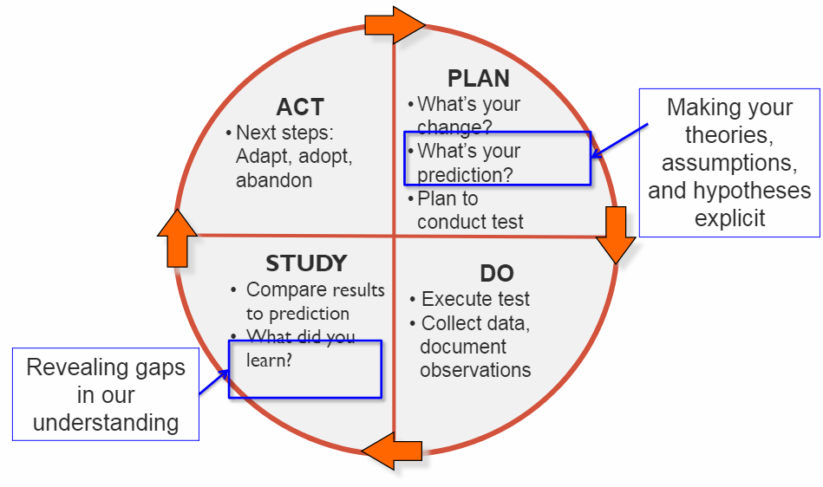
Iterative Cycles of Trial & Learning
Notes:
During the planning phase of the PDSA cycle, it is important to make predictions about what you think will happen when the change is implemented. What do you expect to see in terms of teacher and student behavior, as well as any systems related issues that may be impacted. During the “do” phase you are implementing the change, as intended, and collecting relevant data and information about student progress, as well as any process or implementation factors that need to be considered for adjustment, spread, or scale. During the study and act phases, you are reflecting on the data collected, making sense of the results, and determining whether to adapt the change, adopt it for full implementation, spread or scale, or abandon it in favor of another evidence-based change---all of these decisions should be based on data.

Slide 39
Change Ideas & Measures
Change Ideas from Driver Diagram (CIP) | Measures
Systematic phonics instructional materials, essential practices, aligned formative assessments | Process Measure: Lesson Plans; Observational checklists/walkthrough Outcome Measure: DIBELS Oral Reading Fluency Measures (3 times) Informal Decoding Inventory (3 times) Weekly formative assessments
Daily small group, intensive differentiated instruction, including intensive vocabulary instruction | Process Measure: Lesson Plans; Observational checklists/walkthrough Outcome Measure: Weekly formative assessments
Teacher professional development in SOR | Process Measure: scope, sequence, and frequency of delivery Outcome Measure: Educator judgments on learning survey Observational checklists/walkthrough

Slide 40
Protocol for PDSA Cycle Inquiry
PLAN | DO | STUDY | ACT
Implementation plan: how, where, when and with whom will the practice be implemented? What do you predict will happen as a result of implementing this practice? How will you measure progress toward your goals [e.g., What do you expect to see in terms of students/teacher behaviors, practices, and achievement?] | Carry out the practice, as planned, and collect relevant data/student work. | Was implementation of the practice carried out as planned? What have you learned and how are you making sense of the results? Do these results match your predictions? What did you observe that was surprising? | Regarding this change idea, how might you need to adapt or strengthen it to meet the needs of all students? Does your theory of improvement/Driver Diagram need to be refined? How so?
Notes:
This image illustrates the framework for the PDSA cycle, including guiding questions to consider during each of the phases.
In the “Plan” phase, questions include: How, where, when and with whom will the practice be implemented? What do you predict will happen as a result of implementing this practice? [e.g., What do you expect to see in terms of students/teacher behaviors and practices?]
In the “Do” phase you carry out the practice, as intended, and collect relevant data
During the “Study” phase questions include: Was implementation of the practice carried out as planned? What have you learned and how are you making sense of the results? Do these results match your predictions? What did you observe that was surprising?
Finally, during the “Act” phase questions include: Regarding this change idea, how might you need to adapt or strengthen it to meet the needs of all students? Does our theory of improvement/Driver Diagram need to be refined? How so?

Slide 41
Reflection & Action: Embedding an Inquiry Approach in PLCs
Time
Space/Format
Data-focus (formative & benchmark data; student work)
Student focus (standards, skills, student work, formative assessment)
Inquiry focus (PDSA cycle goals, questions, inquiry, and reflections)
Agendas & facilitation
Notes:
Embedding this type of reflective inquiry cycle into your regularly occurring professional learning community spaces may be one way to develop a habit of data-based inquiry and action among staff. Ensure the time, space, and appropriate format for such community learning. Be sure to keep the inquiry focused on data and students, and ensure that explicit agendas and facilitation are in order to keep everything on track.

Slide 42
Coin Spin Activity
Notes:
Josh

Slide 43
Coin Spin Learning Objectives
Understand rapid cycle PDSA testing
Understand how theory and prediction help you learn
Collect real time data for measurement
Practice learning as a team
Notes:
Josh

Slide 44
Coin Spin Activity Materials and Roles
Four coins
Time piece
Assign and timekeeper
Assign a spinner
Assign a recorder
PDSA tracker
Notes:
Josh

Slide 45
Coin Spin Activity Directions
Write the problem you are trying to solve, change idea, and prediction
Spin as many times as you can in 15 minutes
Use any of the 4 coins. Use any technique. Use any surface
Time starts when you begin your spin and ends when the coin stops
Observe, record, test again
Notes:
Josh

Slide 46
Coin Spin Activity Examples
Question: What is the optimal surface for spinning a coin?
Theory: A smoother surface will allow the coin to spin longer.
Prediction: A polished table surface will yield a longer spin time than a rug.
Observation: A polished table yielded a 10-second spin, while the rug yielded a 5-second spin.
Adapt: A different surface (e.g., glass, metal) will be tested to see if it yields a longer spin.
Notes:
Josh

Slide 47
Coin Spin Activity
What initial theories did you have?
What were the results of initial tests and how did you adjust for additional tests?
What are final theories about what made the coin spin longer?
What would you have done differently?
Notes:
Josh

Slide 48
Coin Spin Activity – PDSA Cycles
Like what we've learned today about PDSA cycles, during this activity you:
tested hypotheses
collected data
analyzed results
adjusted your strategies to improve the outcome
Notes:
Josh

Slide 49
Improvement Project
Apply the processes highlighted today, create a PPT presentation that summarizes:
What do your data reveal about current state/challenges/effects you would like to address?
What are the root causes of these effects?
What are the clear, measurable goals you wish to accomplish?
What, for whom, by when, by how much?
What are the evidence-based change ideas you might select to implement?
What is your [PDSA] plan for implementation, data collection, and frequent monitoring of your progress toward reaching your goal(s)?
Notes:
Lori

Slide 50
Homework
Brainstorm with your team:
Focus area for improvement project
Data to be analyzed
Roles and responsibilities for project tasks and presentation
Notes:
Simona -

Slide 51
Exit Ticket
Notes:
Simona -

Slide 52
Day Two
Notes:
Marianna

Slide 53
What We Heard From Exit Tickets from Day 1
Morning check in
Questions
Notes:
Marianna

Slide 54
Day Two Agenda.
What we heard from exit tickets
Data and Root Cause/Causal Analysis
Problem of Practices and Clear Measurable Goals
Activity
Homework and Exit Ticket
Notes:
Marianna

Slide 55
Data Types
What are the four data types and some examples?
Notes:
Reminder pop is determined these data
Go through 4 slides of the data

Slide 56
Demographic Data
Evidence related to student ethnicity, race, gender, grade level, attendance, teacher retention and teacher experience.
Tools/instruments used to collect these data include, surveys, interviews, applications etc.
Sample guiding questions for analyzing demographic data:
Who are our students/teachers?
What trends do we see in our student population?
What factors outside the school may help us understand our students?
What trends do we see in teacher retention and experience?
Notes:
Demographic data produces evidence related to student ethnicity, race, gender, grade level, attendance, teacher retention and teacher experience. Specific measurement instruments you might use to collect these data include, but are not limited to: surveys, interviews, and applications. Questions these data may answer include:
Who are our students/teachers?
What trends do we see in our student population?
What factors outside the school may help us understand our students?
What trends do we see in teacher retention and experience?

Slide 57
Student Learning Data
Evidence related to students’ learning that shows: the knowledge, skills, and understandings students have achieved; the degree to which our students show the conceptual understandings and generalizations in our standards; and which students are/are not meeting or exceeding our achievement expectations.
Tools/Instruments to collect these data include student work/products, as well as screening, diagnostic, progress monitoring, formative, benchmark, and summative assessment data.
Sample Guiding Questions for Analyzing Academic/Student Outcome Data:
What are the data telling us?
What do we know about how each individual student learns?
Are all subgroups of students performing at the optimal level?
What good news is there to celebrate?
What are the problems of practice suggested by the data?
Notes:
Student learning data produces evidence related to the knowledge, skills, and understandings students have achieved; the degree to which students show the conceptual understandings and generalizations in our standards; and which students are/are not meeting or exceeding our achievement expectations. Specific measurement instruments you might use to collect these data include, but are not limited to: work/products, as well as screening, diagnostic, progress monitoring, formative, benchmark, and summative assessment data. Questions these data may answer include:
What do we know about how each individual student learns?
Are all subgroups of students performing at the optimal level?
What trends and patterns are observed for all students and each sub-group? Be specific. What are the important trends and patterns that will support the identification of student, teacher, and leader needs?
What good news is there to celebrate?
What are the problems of practice suggested by the data?

Slide 58
School Process Data
Evidence related to quality of school processes and programs, including the use of evidence-based instructional practices; curriculum alignment; professional learning and participation; processes for staff evaluation, program effectiveness, MTSS implementation.
Tools/instruments to collect these data may include, observations, checklists, process maps, team records, curriculum maps, scope & sequence documents, etc.
Sample Guiding Questions for Analyzing System Process Data:
How successful are our programs in bringing about the academic excellence articulated in our standards?
How do our assessments/curricular & instructional materials align with expected student standards?
How are we ensuring needs-based professional development for all staff?
How is our Educational Services Team and related processes ensuring that all student needs are met?
How is our Multi-tiered System of Supports framework, and related process, ensuring that all student needs are met?
Notes:
School Process data describes and assesses the quality of school processes and programs, including the use of evidence-based instructional practices; curriculum alignment to standards and research; vertical and horizontal curriculum alignment across grade bands; professional learning and participation; processes for evaluating staff, resource distribution, program effectiveness, continuous improvement, and MTSS implementation.
Specific measurement instruments you might use to collect these data include, but are not limited to: observations, checklists, process maps, team records, curriculum maps, scope & sequence documents and alignment to literacy research, professional learning plans, employee evaluation records, and other implementation tools that relate to the process data identified above.
Questions these data may answer include:
How successful are our programs in bringing about the academic excellence articulated in our standards?
How do our assessments/curricular & instructional materials align with expected student standards?
How are we ensuring needs-based professional development for all staff?
How is our Educational Services Team and related processes ensuring that all student needs are met?
How is our Multi-tiered System of Supports framework, and related process, ensuring that all student needs are met?

Slide 59
Perceptions Data
Evidence that shows perceptions (beliefs, values, observations, attitudes) of the learning environment.
Tools/Instruments to collect these data may include, surveys, empathy interviews, focus groups, observations, Student Journey Maps etc.
Sample Guiding Questions for Analyzing Perceptions Data:
How do the members of our school community feel about our school and district?
How satisfied are school community members about our educational programs?
What do the members of our school community perceive to be the strengths and needs in our school?
What do the members of our school community think about the skills of our graduates?
Notes:
Perceptions data produces evidence that reveals perceptions (i.e., beliefs, values, observations or attitudes) about the learning environment. Specific measurement instruments you could use to collect these data include surveys, empathy interviews, focus groups, and journey maps. Questions that these data may help answer include:
How do the members of our school community feel about our school and district?
How satisfied are school community members about our educational programs?
What do the members of our school community perceive to be the strengths and needs in our school?
What do the members of our school community think about the skills of our graduates?

Slide 60
Problem of Practice
Notes:
Toni - The purpose of this section is to assist teams in understanding what a problem of practice is as well as identifying the problem(s) that are most pervasive or have the greatest impact on the school or district.
The ultimate goal is to identify and select a problem of practice, based on the data, to address as a team

Slide 61
Identifying Problems of Practice.
In what general area(s) are out outcomes not meeting shared expectations?
What discrepancies, patterns or trends within this focus area do the data reveal?
What unmet student needs have we uncovered, and which are the most important to address?
Notes:
Toni –
The second stage in conducting a comprehensive needs assessment is identifying problems of practice beginning with the selection of focus areas. Focus areas are general areas of need revealed during the broad data overview and provide an initial direction for a deeper data analysis.
Let's use lagging science outcomes over the past three years as an example. With a focus area or areas agreed upon the team identifies and collects additional data related to this area as needed. From there the team makes factual observations about the data. The observations should be free of assumptions or biases describing indisputable points, discrepancies patterns, or trends in the data. Once you have a clear picture of the facts revealed by the data move on to making inferences about what these facts are telling you.
When sufficient data has been collected, observations made, and inferences drawn, a problem of practice within the focus area is identified. In the case of our science outcomes focus, let's say that scores in the discipline of physical sciences have been noticeably lower than in other areas. In the light of time and resource limitations it's often necessary for teams to prioritize their problems of practice. When prioritizing problems of practice ask yourselves which unmet student needs have we uncovered, and which are the most important to address.

Slide 62
A Problem of Practice is:
Related to the instructional core
Directly observable
Actionable
Connected to a broader improvement strategy
Notes:
A "problem of practice" is an issue or area of concern in a specific context, like a school or organization, that leaders and teachers are aware of but haven't found clear solutions for.
It's a focus area where they are seeking improvement, but the specific obstacles and pathways to progress are not yet well understood.
Here's a more detailed explanation:
Focus on the instructional core:
Problems of practice are typically related to teaching, learning, and the instructional processes within a school or district, rather than broader contextual issues.
Observable and actionable:
The issue should be directly observable, meaning you can see it happening and it's within your control to improve.
Connects to broader improvement goals:
The problem should be related to a larger strategy for improving student learning and overall school performance.
High leverage:
Addressing the problem should have a significant positive impact on student learning or other important outcomes.
Used in different contexts:
Problems of practice are used in various educational settings, such as school-based instructional rounds and doctoral programs, to guide improvement efforts.
For example, a problem of practice could be:
"Low student engagement in math lessons".
"High rates of student absenteeism".
"Limited access to digital resources for all students"

Slide 63
Problem of Practice (PoP)
Choose Broad focus
Recognize trends in data
making inferences about what these facts are telling you. These inferences based on logically and factual observations
Conclusion = Problem of Practice
Notes:
Once you have a clear picture of the facts revelated by data, move on to making inferences about what these facts are telling you. These inferences should be based logically on your factual observations. Often times, additional evidence will be needed to support an inference, leading to more data collection and observations/s
Examples: Through generally interested, our students are either not aware of or not able to participate in the full range of Flexible Pathways options available to them.
There is a gap in essential foundational skills necessary to proficiently solve word problems at the third grade level
There is a difference in expectations in instructional practices for teaching Number Sense, Quantity, Counting and Number Relationships and Operations/Problem Solving at the early math primary learning levels
Once sufficient data has been collected, observations made, and inferences drawn, a tentative conclusion can be made. This conclusion becomes the problem of practice, a hypothesis which has enough evidence supporting it to merit further analysis. It my be revised as new data is explored, and insights are gained.
Examples: Few 11 and 12 grade students are participating in Flexible Pathways options, contributing to a high degree of dissatisfactions with personalization efforts at our school.
Low Achievement in the areas of number sense and problem solving are resulting in a decline in overall math proficiency in third grade students
\Not all teachers apply consistent high quality instructional practices in mathematics in K-3 grade
Due to time and resource limitations, it is often necessary for teams to prioritize their problems of practice. When prioritizing pop's, ask: Which unmet student needs have we uncovered, and which are the most important to address?

Slide 64
The Inference Ladder
Actions – Why do I believe this to be the right action? What are some alternatives options?
Beliefs – What beliefs do I hold about this? What conclusions are they based on?
Conclusions – Why did I conclude this? What are my assumptions here
Assumptions – Are my assumptions valid? Why and I assuming this?
Interpretations – Am I looking at this data objectively? What other meanings could they have?
Selected data – What did I ignore or didn’t pay attention to? Are there other sources of data I didn’t consider?
Available data – Observable reality
Notes:
We act and make decisions based on the conclusions we make. But we tend to jump to these conclusions and skip important parts of the reasoning process.
The Ladder of inference, developed by a former Harvard professor Chris Argyris, is a tool that helps you fill the gaps in your thinking and make decisions based on reality. It's also helpful to challenge the thinking of others and reach better conclusions together.
The ladder
There are 7 steps on the ladder that represent our mental processes. Here's what it looks like from the bottom up:
Available data
This is the reality we are able to observe.
Selected data
We select what we pay attention to based on our prior experiences and existing beliefs. We don't have the mental capacity to take in every piece of data available, so we have to make this selection.
Interpretations
We give facts meaning. We paraphrase what we see or hear to make sense of it.
Assumptions
Based on our interpretation, we make our own personal assumptions.
Conclusions
We draw conclusions from our assumptions.
Beliefs
Our beliefs are then developed from the conclusions we make.
Actions
Finally, we take actions that are rooted in what we believe to be true.
These processes usually happen unconsciously and very quickly in our brain. Applying this ladder consciously allows you to take a step back and see where you're jumping to conclusions.

Slide 65
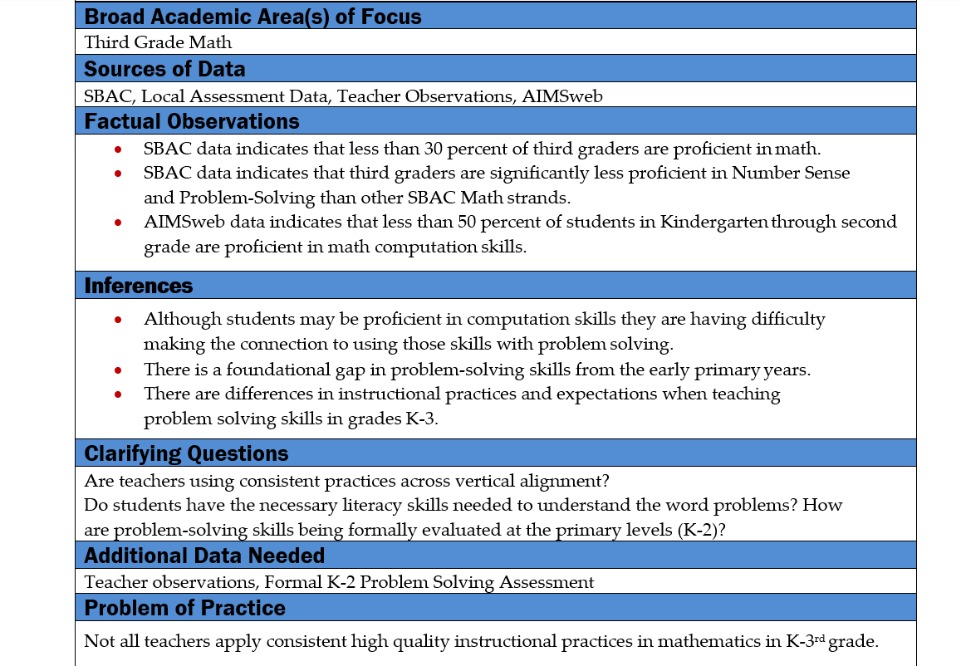
Problem of Practice Worksheet
Notes:
Purpose: To explore data within your selected broad academic area(s) of focus, ultimately arriving at a Problem (or Problems) of Practice.
Directions:
Record your broad academic area(s) of focus and sources of data to be considered.
As a team, make factual observations about the data presented, looking for trends, patterns, or discrepancies.
Infer meaning from your factual observations. What might the data be telling you?
Ask clarifying questions to be answered, based on your inferences, and assemble the additional data needed to answer them.
Repeat this activity with your additional data until you’ve identified a clear
problem(s) of practice within your broad academic area(s) of focus.

Slide 66
Problem of Practice Examples
Low student engagement in math lessons
High rates of student absenteeism
Limited access to digital resources for all students
Not all teachers apply consistent high-quality instructional practices in math in k-3rd grade
Few 11th and 12th grade students are participating in Flexible Pathways options, contributing to a higher degree of dissatisfaction with personalization efforts at our school

Slide 67
Causal Analysis

Slide 68
Common ways of finding root causes are:
5-Whys
Root Cause Analysis
A causal analysis can be performed in many different ways.
The purpose is always the same: finding the root cause of a problem.
We will talk about the details of the two methods in a moment.
We are going to start with some important principles.

Slide 69
Keep in Mind…
5 whys are not needed to satisfy the “5 Whys”. Stop when you arrive at the root cause!
No tautologies!
Why are students with FRL performing lower on ELA and Math assessments? → Because they are not consistently meeting grade-level proficiency benchmarks in these subjects.
Each cause must follow logically from the previous one.
Problem:
Students who are not proficient are not getting adequate support in Math.
Here is an example of what not to do:
Many students struggle with the curriculum
Instead, a good cause would be
Adequate support is not provided because teachers are not well trained in the new curriculum

Slide 70
Conduct and Verify your Causal Analysis
Do multiple data sources support the identification of this root cause?
Can anything else, besides this cause, lead to the stated effect?
Is this root cause within the school’s control?
Is this root cause focused on adult actions?
Will the elimination of this cause change the outcome?

Slide 71
Conduct and Verify your Causal Analysis
Does the data really indicate that the cause substantially contributed to the problem?
Correlation
Chronological sequence
Mechanism of causation
Other possible causes

Slide 72
Examples
Correlation
Problem
English learners are performing 20 percentage points lower than their peers in Math
Cause 1: 15% of the student population is experiencing homelessness.
Cause 2: 75% of English learners scored “Not proficient” in VTCAP.
Chronological sequence
Problem
25% of students in K-3 were not proficient in reading, based on SY24-25 DIBELS scores.
Cause 1: Our reading specialist resigned at the end of SY24-25.
Cause 2: Our reading specialist resigned at the beginning of SY24-25.

Slide 73
Examples.
Mechanism of causation
Problem
17% of students of students report not having a sense of belonging to their school.
Cause 1: MTSS is not applied consistently.
Cause 2: The students with the lowest performance are reporting not having a sense of belong to the school.
Other possible causes
Problem
40% of students miss 20 or more days of school a year.
Cause 1: Most of our teachers are not trained in culturally-sensitive approaches.
Cause 2: The importance of school attendance is not perceived in 30% of students’ families.

Slide 74
Identify Underlying Systemic Causes of Challenges.
CAUSES
EFFECT
Fishbone/Cause & Effect Diagram
Vermont Continuous Improvement Website
Notes:
Lori - As you are summarizing the challenges, you can use a root cause analysis/cause and effect diagram to uncover and confirm the underlying root causes of challenges or problems of practices, to ensure that you are solving the right problem. We have tools in the Comprehensive Needs Assessment Toolkit on our Continuous Improvement website to help you facilitate this process.

Slide 75
Sample Root Cause Analysis.
Notes:
Lori - Here is a sample causal analysis, or fishbone diagram. The stated problem of practice appears at the top (or the head of the fishbone diagram). In this case it is “some systems, processes, and /or practices in Mathematics/Literacy are not meeting the needs of many students because… The major causal categories related to this problem of practice include curriculum, instruction and assessment, culture, and system coherence and consistency. Some of the root causes, across these categories include inconsistency and incoherence in instructional practices, educators lacking the necessary content or pedagogical knowledge, insufficient rigor in the curriculum to match expectations, variation in educator expertise and qualifications, and weak home-school alignment and partnerships.

Slide 76
Cause and Effect Tool: Fishbone Diagram
Notes:
Lori - Show the process with chart paper example with room

Slide 77
Break Time!!
Notes:
Josh

Slide 78
Clear Measurable Goals
Notes:
Toni
The purpose of this section is to assist teams in establishing common strategies, goals, and objectives for addressing the selected problem of practice. This includes identifying strategies that outline how the team will address each problem of practice as well as setting a vision for the work that is multiyear, aspirational, and specific to the identified problem of practice. This section also includes goal-setting to define success for the coming year’s efforts

Slide 79
Goal Setting and Action Planning
Goal-setting helps to make sure everyone is on the same page and working toward common objectives.
Goals should tie into overarching educational improvement objectives while directly addressing the identified problems.
Action plans will serve as a guide for the implementation of the proposed solutions. It should outline the strategies that will be used to address each problem of practice.
Strategies can be tried using the PDSA cycle.
Notes:
Goal-setting and action planning
Once you’ve identified the problem to be addressed and some possible solutions for solving it, you’ll need clear goals and a detailed road map that sets out the action steps to be taken.
Goal-setting will help make sure everyone is on the same page and working toward common objectives. The goals should be aspirational and multiyear and should tie into overarching educational improvement objectives while directly addressing the identified problems.
The action plan will serve as a guide for the implementation of the proposed solutions. It should outline the strategies that will be used to address each problem of practice.
The strategies can be tried using the PDSA cycle. Choosing a strategy to address the problem and testing it to gain perspective on what works, what doesn’t, and what needs to be done or redone.

Slide 80
Setting Clear and Measurable Student Learning Goals
Quality Aim/Goal statements include these components:
What? (operationalize the specific skill/process/practice that is being improved?)
For whom? (who is the intended population?)
By when? (when do you expect outcomes to be achieved?)
By how much? (to what degree will improvement/progress be made by that time?)
e.g., By June 2024, 90% of K-3rd grade English Learners are reaching proficiency in grade level reading fluency, as measured by Decoding Inventories & Oral Reading Fluency Assessments.
e.g., By June 2024 we will reduce the math/literacy performance gap for English Learners and their peers by 20%
Notes:
Setting clear, measurable student learning goals entails 4 basic criteria (what, for whom, by when, and by how much). The What component operationalizes the specific skills/processes/practices that are being improved? The For whom component identifies the intended population for whom the goal is set? The By when component identifies when you expect outcomes to be achieved, and the By how much? Component indicates the degree of improvement you expect will be made by that time. So, in this case, the highlighted example shows specific goals related to the data findings for English Learners.

Slide 81
Keep the Grain Size in Mind
Is the goal/problem of practice at a:
Systems level?
School level?
Grade or class level?
Content area level?
Student level?
Notes:
Let's talk a little bit about grain size and considerations...
The grain size is about the work you are doing and what your focus should be on. Grain size is very important... so take into consideration where the problem of practice is occurring and write the goal specific to that grain size. Is your problem of practice occurring at the district or SU level, school level, grade or class level, content area level, or student level.
Another consideration is what does your data show? Data should be paired with key findings that represent an initial analysis of both the current state of data and trends over time.
You want your grain size to be simple and focused. You can always start small and expand the grain size as you move though the process.
If you need help with getting to, or determining the grain size, your EQC or the team can help you narrow your focus prior to you submitting your CIP. Please reach out, as we are always willing to help.

Slide 82
Examples – Clear Measurable Goals
Increased reading fluency:
All students will read a grade-level passage at 70 words per minute with 3 or fewer miscues, as measured by the mCLASS: TRC assessment by a specific date.
Reduced math errors:
All students will reduce math errors from 10% to 5% on weekly assessments by a specific date.
Improved attendance:
All students will attend school 90% of the time, with documented evidence of attendance, by a specific date.
Enhanced social skills:
All students will demonstrate improved social skills in a specific classroom setting, measured through observations and teacher ratings, by a specific date.
Notes:
In MTSS, clear and measurable goals help educators track student progress and determine the effectiveness of interventions
These examples demonstrate the need to be specific about the outcome, how it will be measured, and the timeframe for achieving it. They also highlight the importance of focusing on observable behaviors and utilizing standardized assessments to track progress, according to Branching Minds and other resources.

Slide 83
What are other examples of clear measurable goals?

Slide 84
Activity
Let's go fishing!
Notes:
Marianna -

Slide 85
Fishing Frenzy
Like a Kahoot!
Play by yourself.
Use your computer, tablet, or phone to access the URL or the QR code.
Questions will only appear on your device.
Seven minutes to answer a series of multiple choice and true or false questions to test your knowledge on setting clear and measurable goals.
Whoever gets the highest weight wins!
Speed and accuracy affect the weight of the fish you get.
play.blooket.complay.blooket.co
Are you ready?
Notes:
Marianna -
Time to have some fun learning about clear and measurable goal setting!
How many of you have used Kahoot in your classes?
Well this is like a Kahoot.
Play by yourself.
You can use your computer or your phone.
There will be two ways to access the game, either through a URL or a QR code.
The point of the game is to get the most or the highest weight of fish.

Slide 86
Recap of Fishing Frenzy
Are there any questions?
Recap:
a. Goals are made of 4 questions:
i. ?
ii. For?
iii. By?
iv. By?
Notes:
Marianna
Congratulations to the Winner!!!
Are there any questions?
Let's recap
Clear and Measurable goals are made up of what 4 questions?
What?
For Whom?
By When?
By How Much?

Slide 87
Recap Example One
Which of the following most accurately represents the “What” in this goal?
“By June 2025, 60% of 3rd grade students will increase their reading fluency by 15 correct words per minute.”
A) 3rd grade students B) June 2025 C) Increase in reading fluency D) 60%
Notes:
Marianna
And the Answer Is????
Letter C
Explanation: The “What” refers to the targeted content/skill area—in this case, reading fluency OR LETTER C.

Slide 88
Recap Example Two
True or False?
A goal written as “Improve 5th graders’ science test scores by 10% by the end of the year” is fully measurable and complete.
TRUE
Notes:
Marianna
Correct Answer: True Explanation: It contains a clear target (10% improvement), audience (5th graders), subject area (science scores), and deadline (end of year).

Slide 89
Recap Example Three
Which of the following is a common mistake when writing student outcome goals?
A) Including multiple metrics in a single goal
B) Leaving out the targeted group of students C) Making the goal too specific to one content area D) Writing a goal that spans more than one year
Notes:
Marianna
Correct Answer: B Explanation: Not identifying “For Whom” makes the goal too vague and limits its usefulness.

Slide 90
Recap Example Five
You observe a teacher sets this goal: “Students will participate more actively in class discussions.” What is the best revision using the goal-setting framework? A) Increase student participation by assigning more discussions. B) All students will improve engagement. C) By June 2025, 80% of students will contribute at least twice per week to class discussions. D) Students will be encouraged to talk more in class.
Notes:
Marianna
Correct Answer: C Explanation: This version includes a measurable target (twice per week), a timeframe, and identifies the audience.

Slide 91
Recap of Day Two
Data and Root Cause/Causal Analysis
Problem of Practices and Clear Measurable Goals
Activity
Homework and Exit Ticket
Notes:
Josh

Slide 92
Day Two Homework
Notes:
Josh – Apply what we learned today to your challenge (root cause analysis, identifying a problem of practice, and setting clear measurable goals)

Slide 93
Day Two Exit Ticket
Notes:
Josh

Slide 94
Day Three
Notes:
Toni

Slide 95
What We Heard From Exit Tickets from Day 2
Notes:
Toni

Slide 96
Day Three Agenda.
What we heard from Exit Tickets
Evidence-Based Practices and Change Ideas
Data/Measurement Plans
Activity
Homework and Exit Ticket
Notes:
Toni

Slide 97
EBP/Change ideas
Notes:
Simona (EBP, Change Ideas, Data Measurement Plan)

Slide 98
How to Select Change Ideas and Best Practices
Elementary and Secondary Education Act of 1965, as amended, requires the selection, use, and building of evidence-based activities, strategies, and interventions (“Non-Regulatory Guidance: Using Evidence to Strengthen Education Investments” (9/28/2023).
Refer to basic research rules:
Only use reliable sources
peer-reviewed work (i.e., published in professional journals);
Institute of Education Sciences (IES);
Non-Regulatory Guidance: Using Evidence to Strengthen Education Investments (9/28/2023);
Other sources that follow the same standards.
Verify the size and quality of the sample.
Meta-analyses can be useful, but not as the only basis for the change idea.
“Statistically significant” and “significant effect” are not synonyms.
A great study is not necessarily a useful study.
No blogs, please!
Ask your EQC! We are here to help.

Slide 99
Levels of Evidence
Evidence Requirement | Strong Evidence | Moderate Evidence | Promising Evidence | Demonstrates a Rationale
Outcomes | At least one statistically significant and positive effect on a relevant outcome; no statistically significant and negative effects on a relevant outcome | At least one statistically significant and positive effect on a relevant outcome; no statistically significant and negative effects on a relevant outcome | At least one statistically significant and positive effect on a relevant outcome | Not Applicable
Study Design | Experimental study | Experimental study or quasi-experimental design study | Experimental study, quasi-experimental design study, or correlational study with statistical controls for selection bias | Logic model informed by research or evaluation findings
WWC Evidence Rating | Meets WWC without reservations | Meets WWC with or without reservations | Not Applicable | Not Applicable
Sample Size | A large sample (n = 350+) and a multisite sample | A large sample (n = 350+) and a multisite sample | Not Applicable | Not Applicable
Table from “Non-Regulatory Guidance: Using Evidence to Strengthen Education Investments” (9/28/2023).

Slide 100
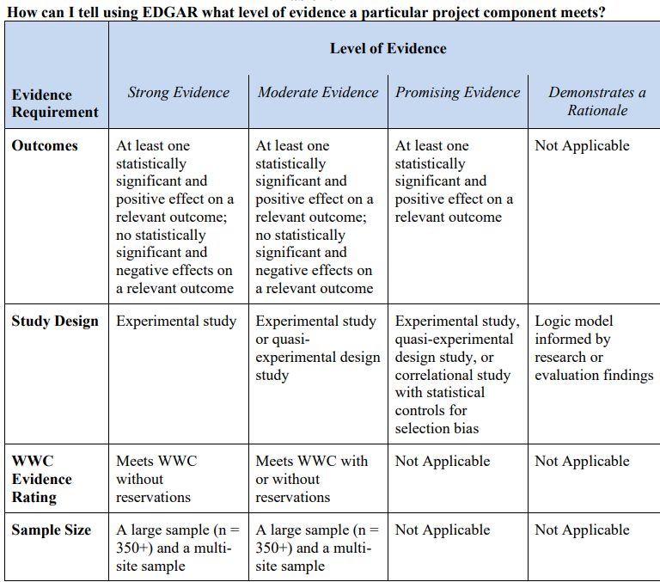
Levels of Evidence.
Table from “Non-Regulatory Guidance: Using Evidence to Strengthen Education Investments” (9/28/2023)

Slide 101
Break Time!!!
Notes:
Josh

Slide 102
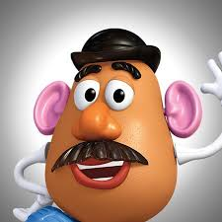
PDSA
Notes:
Josh – Potato Head activity – 1 hour and 15 min

Slide 103
Using PDSA to Fine Tune Goal and to Test Change Ideas
Aim: All participants will build an accurate replica of Mr. Potato Head, with efficiency.
Operationally Defining the Expectations:
Accuracy: As displayed in photo/image/model
1 = Fewer than 6 pieces are accurately positioned on the head
2 = At least 6 pieces are accurately positioned on the head
3 = All pieces are placed on the head accurately
Speed: Expectation is under 20 seconds--Measured in minutes and seconds using a phone timer. Start when the timekeeper says go. Stop timing when builder says, “finished” with hands in the air.
Use Data Tracker to record data
Notes:
Josh - SEE DEBRIEF SECTION: https://www.davidmwilliamsphd.com/mr-potato-head-pdsa/step-four-debrief/

Slide 104
Mr. Potato Head Activity
P – Plan your strategy and document
D – Timer starts when you begin. Say "time" when finished
S – Inspector checks for accuracy and documents score
A – Debrief to adopt, adapt or abandon. Repeat activity.
Notes:
Josh

Slide 105
Mr. Potato Head Activity - Roles
Roles to assign
A timekeeper
A recorder
An assembler
An inspector
Notes:
Josh – have teams assign roles

Slide 106
Mr. Potato Head Activity.
Accuracy: As displayed in photo/image/model
1 = Fewer than 6 pieces are accurately positioned on the head
2 = At least 6 pieces are accurately positioned on the head
3 = All pieces are placed on the head accurately
Speed: Expectation is under 20 seconds--Measured in minutes and seconds using a phone timer. Start when the timekeeper says go. Stop timing when builder says, “finished” with hands in the air.
Notes:
Josh – Keep on screen during the activity

Slide 107
Mr. Potato Head Debrief
How many strategies did you try and what were they?
Ultimately, which strategy worked the best?
Test vs Talk
Time vs Accuracy
Testing considerations
Documentation
Collaboration
Notes:
Josh – Ask questions and discuss the importance of each – CI context

Slide 108
Day Three Homework
Continue to work on improvement projects for presentations tomorrow
Notes:
Marianna

Slide 109
Exit Ticket Time!
Notes:
Marianna

Slide 110
Day Four
Notes:
Josh

Slide 111
What we heard from exit tickets from Day 3
Notes:
Josh – Review learning from Exit Tickets

Slide 112
Today's Agenda
Improvement Project work time
Presentations
Extended break time
Presentations
Wrap Up
Notes:
Josh – Review today's agenda

Slide 113
Improvement Project Work Time
Notes:
Josh

Slide 114
Presentations
Notes:
Josh

Slide 115
Break Time
Notes:
Josh

Slide 116
Presentations.
Notes:
Josh

Slide 117
Day Four Wrap Up!
Evaluation
THANK YOU!!

